Slide 1



Noida Institute of Engineering and Technology, Greater Noida
Statistics & Probability
AAS0303
Unit: II
Probability and Random Variable
Dr. Anil Agarwal
Associate Professor
Dept. of Mathematics
AIML-3rd Sem
Unit-II

Slide 2
Content(CO2)
Introduction
Addition Law of Probability
Multiplication Law of Probability
Conditional Probability
Bayes’ Theorem
Random Variables
Probability mass function
Probability density function
Mathematical Expectation, Mean , Variance
Moment generating function
Two dimensional random variables, PMF, PDF
Unit-II

Slide 3
Course Outcome
CO1. Gaining Knowledge of basic concept / fundamentals of statistics and various measures of central tendency and Measures of Dispersion.
CO2. The course provides the knowledge of the Probability and random and with some basic PMF & PDF, Moment generating function etc.
CO3. The course enables the student to understand the various Probability distributions.
CO4. Understand the basic concepts of Statistical inferences and test of Hypothesis.
CO5. To solve the Problems of time & work, Pipe & Cistern, Boat & stream, Clock & Calendar etc.
Unit-II

Slide 4
Unit Objective of Probability Theory (CO2)
A basic knowledge in probability theory.
The student is able to reflect developed mathematical methods in probability and statistics.
Understand the concept of random variable.
4. To explore the key properties, such as the moment-generating function, PMF, PDF etc.
Unit-II

Slide 5
PO
S.No | Program Outcomes (POs)
PO 1 | Engineering Knowledge
PO 2 | Problem Analysis
PO 3 | Design/Development of Solutions
PO 4 | Conduct Investigations of Complex Problems
PO 5 | Modern Tool Usage
PO 6 | The Engineer & Society
PO 7 | Environment and Sustainability
PO 8 | Ethics
PO 9 | Individual & Team Work
PO 10 | Communication
PO 11 | Project Management & Finance
PO 12 | Lifelong Learning
Unit-II

Slide 6
PSO
PSO | Program Specific Outcomes (PSOs)
PSO 1 | To apply knowledge of basic sciences and biotechnological techniques
PSO 2 | To design, optimize, analyze & scale up bioprocesses to develop useful products with societal consideration
PSO 3 | To generate, analyze & interpret biological data using insilico & other relevant approaches.
Unit-II

Slide 7
CO-PO and PSO Mapping
Sr. No | Course Outcome | PO1 | PO2 | PO3 | PO4 | PO5 | PO6 | PO7 | PO8 | PO9 | PO10 | PO11 | PO12
1 | CO 1 |  |  |  |  | H |  |  |  |  |  |  | M
2 | CO 2 |  | M | M |  |  |  | M |  | H
3 | CO 3 |  | H | H |  |  |  |  | M |  | H
4 | CO 4 |  | M | H | M |  | H
5 | CO 5 |  | H | H |  | H |  |  |  |  | M |  | M
*H= High *M= Medium
Program Specific Outcomes | Course Outcomes
 | 1 | 2 | 3 | 4 | 5
1 | M | H | H | H | H
2 | M | M | H | H | H
3 | - | - | - | - | -
*H= High *M= Medium
Unit-II

Slide 8
Topic Objective of Probability(CO2)
The probability theory is very much helpful for making prediction. Estimates and predictions form an important part of research investigation. With the help of statistical methods, we make estimates for the further analysis.
Unit-II

Slide 9
Prerequisite and Recap
Knowledge of combination
Knowledge of permutation
Some basic concepts of set theory.
Unit-II

Slide 10
Introduction(CO2)
Theory of Probability:
Trial and events: The experiment is called trials and the possible outcomes are known as events or cases.
Example: Tossing of a coin is a trial and the running up of the head or tail is an event.
Exhaustive events: The total no of all possible outcomes in any trial is known as exhaustive events or exhaustive cases.
Example: In tossing a coin, there are two exhaustive cases , head and tail.
Favorable events or cases: The total number of possible outcomes in which specified event happens then these specified events are known as Favorable event or cases.
Example: In a throw of two dice , the number of cases favorable to getting a sum 6 is 5 , i.e. (1,5);(2,4); (3,3);(4,2);(5,1)
Unit-II

Slide 11
Cont.. (CO2)
Mutually exclusive events: If no two or more than two of them can happen simultaneously in same trial.
Example: In tossing a coin , then events are head and tail are mutually exclusive, sinc if the outcome is head then the possibility of getting tail in the same trial ruled out.
Equally likely events: Events are said to be equally likely if there is no reasons to expect any one in preference to any other.
Example: In throwing a die ,all the six faces are equally likely to come.
Independent & dependent events: Two or more events are said to be independent if the happening or non happening of any one does depend (or is not affected) by the happening or non happening of any other . Otherwise they are said to be dependent .
Unit II

Slide 12
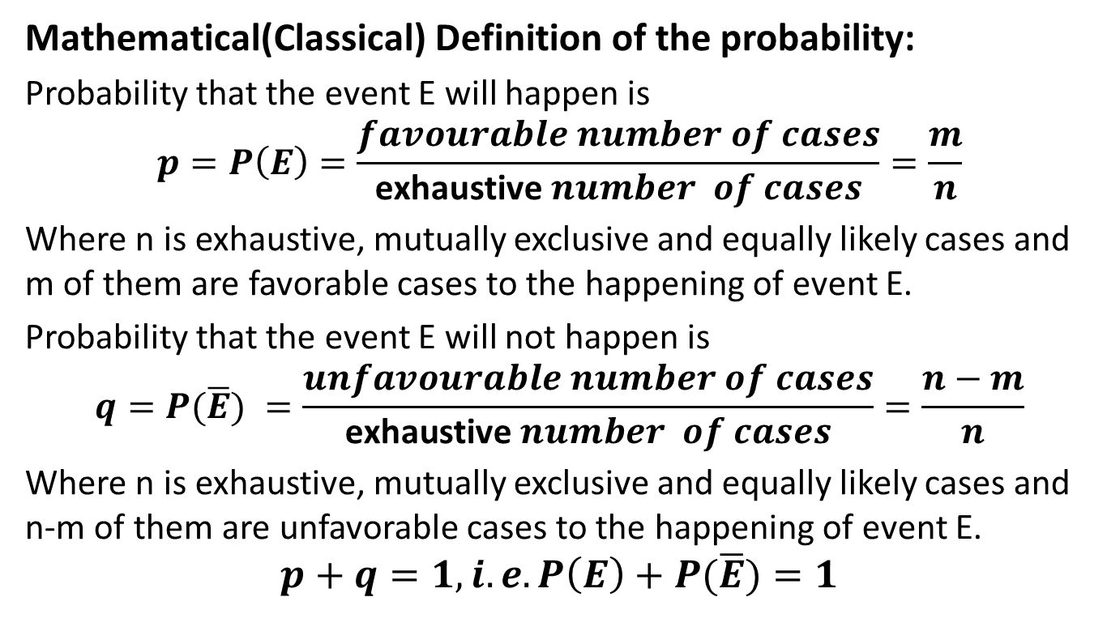
Probability(CO2)
Mathematical(Classical) Definition of the probability:
Probability that the event E will happen is
$$p=P\left(E\right)=\frac{favourable number of cases}{\text{exhaustive} number of cases}=\frac{m}{n}$$
Where n is exhaustive, mutually exclusive and equally likely cases and m of them are favorable cases to the happening of event E.
Probability that the event E will not happen is
$$q=P(\overline{E}) =\frac{unfavourable number of cases}{\text{exhaustive} number of cases}=\frac{n−m}{n}$$
Where n is exhaustive, mutually exclusive and equally likely cases and n-m of them are unfavorable cases to the happening of event E.
$$p+q=1, i.e. P\left(E\right)+P(\overline{E})=1$$
Unit II

Slide 13
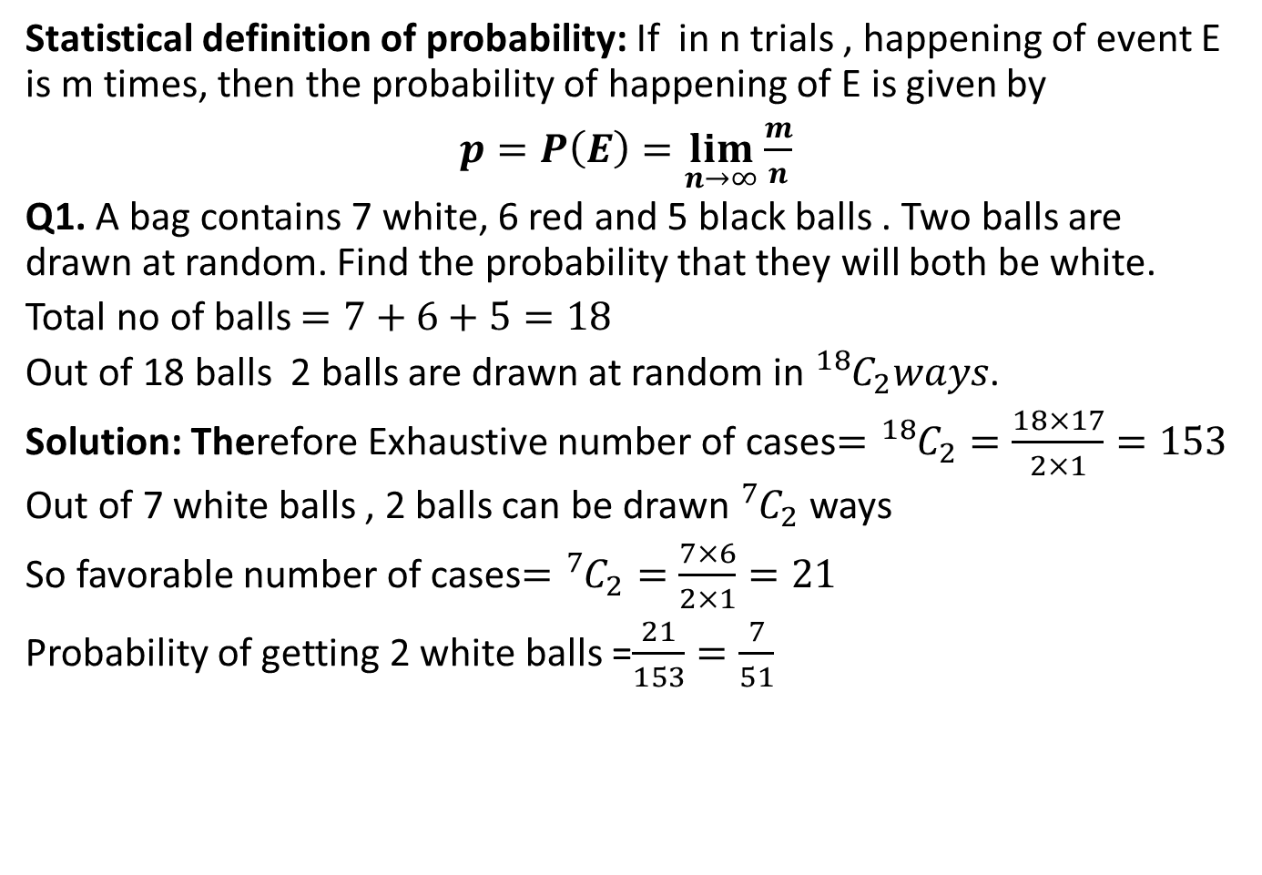
Cont…(CO2)
Statistical definition of probability: If in n trials , happening of event E is m times, then the probability of happening of E is given by
$$p=P\left(E\right)=\lim_{n→∞}{\frac{m}{n}}$$
Q1. A bag contains 7 white, 6 red and 5 black balls . Two balls are drawn at random. Find the probability that they will both be white.
Total no of balls $=7+6+5=18$
Out of 18 balls 2 balls are drawn at random in ${}_{}^{18}{C_{2}}ways$.
Solution: Therefore Exhaustive number of cases$={}_{}^{18}{C_{2}}=\frac{18×17}{2×1}=153$
Out of 7 white balls , 2 balls can be drawn ${}_{}^{7}{C_{2}}$ways
So favorable number of cases$={}_{}^{7}{C_{2}}=\frac{7×6}{2×1}=21$
Probability of getting 2 white balls =$\frac{21}{153}=\frac{7}{51}$
Unit II

Slide 14
Definitions(CO2)
Random Experiments: Whose results can not be predicated before hand is known as Random Experiments.
Example: Tossing a coin, Rolling a die, balls taking out from an urn.
Sample Space: The set of all possible outcomes of a random experiment is called Sample Space and it is denoted by S.
Example : If we are tossing a coin then the outcomes are Head(H) and Tail(T).
So sample space S={H,T}
Sample Points : The element of sample space S are called Sample points.
Unit II

Slide 15
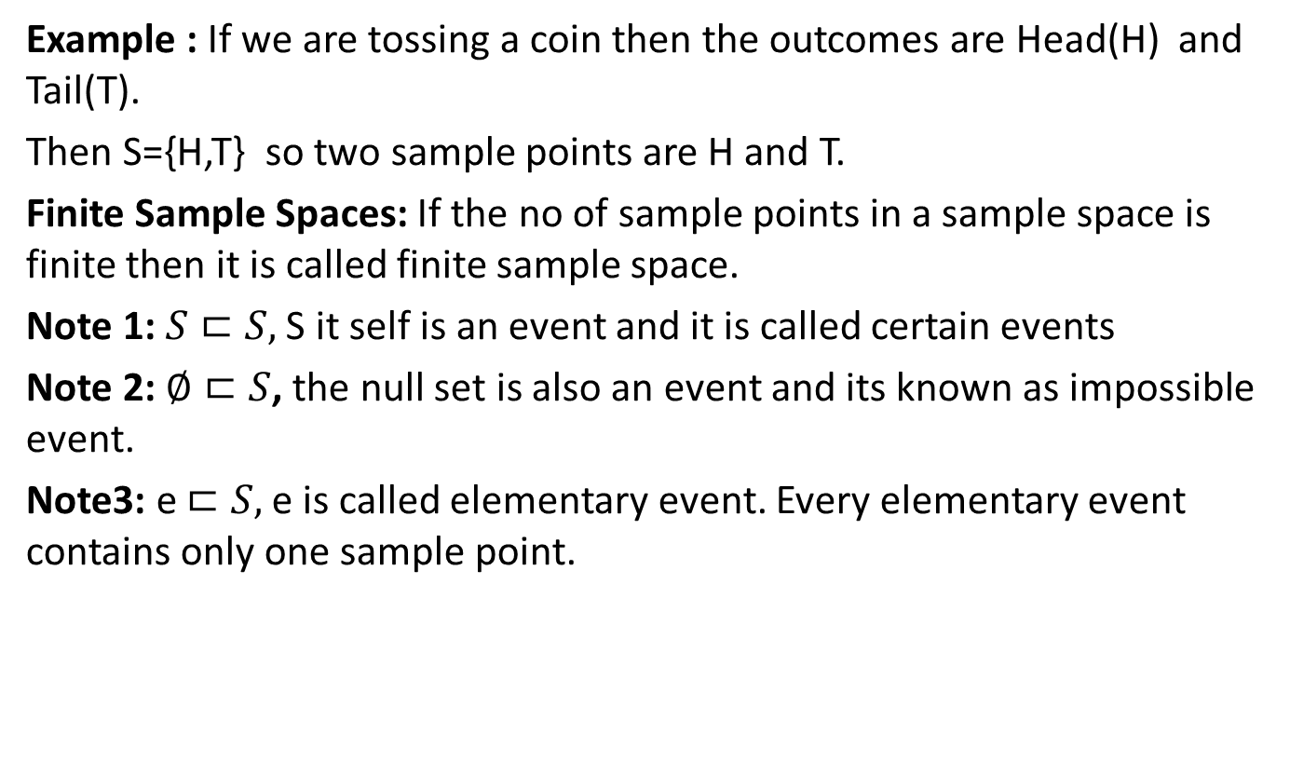
Cont…. (CO2)
Example : If we are tossing a coin then the outcomes are Head(H) and Tail(T).
Then S={H,T} so two sample points are H and T.
Finite Sample Spaces: If the no of sample points in a sample space is finite then it is called finite sample space.
Note 1:$S⊏S,$S it self is an event and it is called certain events
Note 2: $∅⊏S$, the null set is also an event and its known as impossible event.
Note3: e $⊏S,$e is called elementary event. Every elementary event contains only one sample point.
Unit II

Slide 16
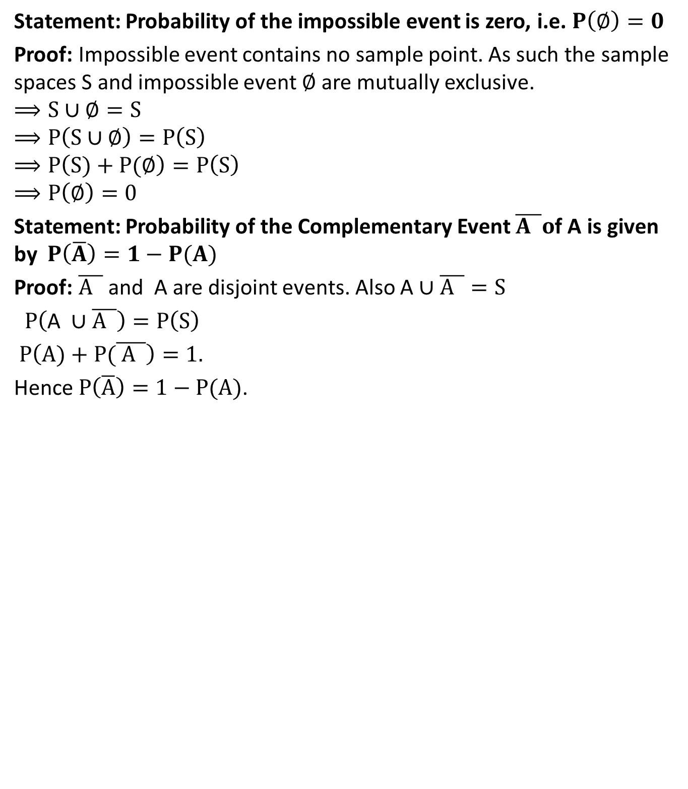
Theorems Based on Probabilities(CO2)
Statement: Probability of the impossible event is zero, i.e. $P\left(∅\right)=0$
Proof: Impossible event contains no sample point. As such the sample spaces S and impossible event $∅$ are mutually exclusive.
$$⟹S∪∅=S$$
$$⟹P\left(S∪∅\right)=P\left(S\right)$$
$$⟹P\left(S)+P(∅\right)=P\left(S\right)$$
$$⟹P\left(∅\right)=0$$
Statement: Probability of the Complementary Event $\overline{A }o$f A is given by $P\left(\overline{A}\right)=1−P(A)$
Proof:$\overline{A }$ and A are disjoint events. Also A $∪\overline{A }=S$
$$P\left(\text{A} ∪\overline{A }\right)=P\left(S\right)$$
$$P\left(A)+P(\overline{ A }\right)=1.$$
Hence $P\left(\overline{A}\right)=1−P(A)$.
Unit II

Slide 17
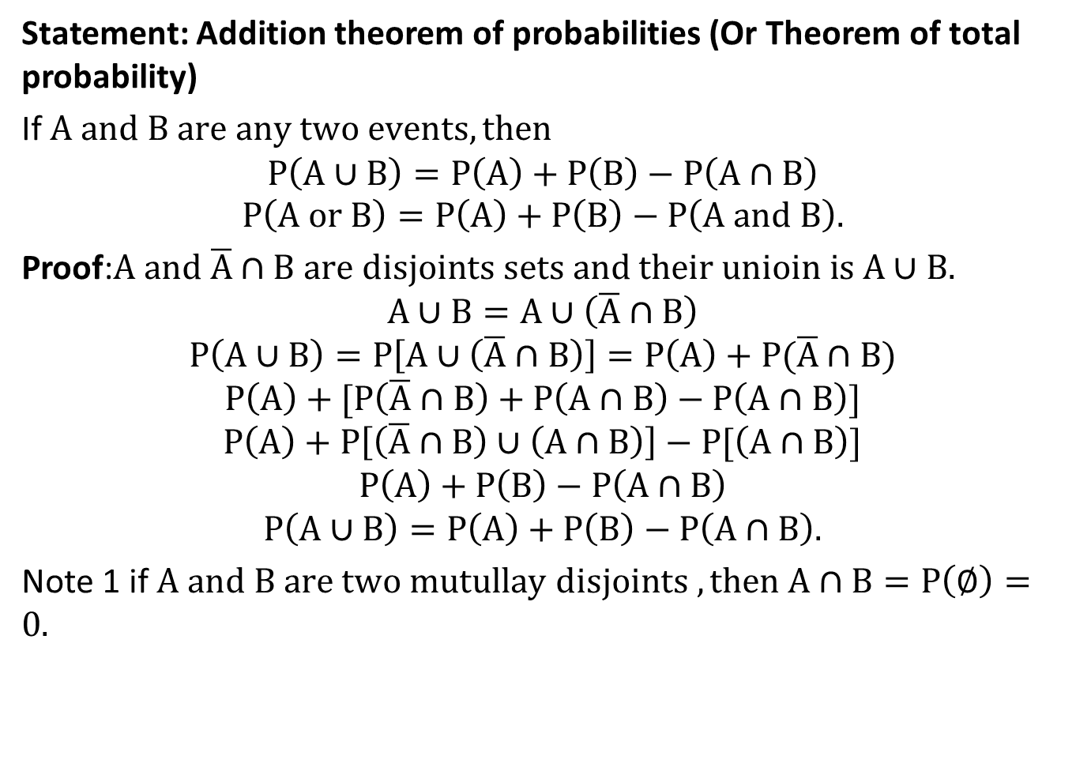
Addition Law of probabilities(CO2)
Statement: Addition theorem of probabilities (Or Theorem of total probability)
If $A and B are any two events,then$
$$P\left(A∪B\right)=P\left(A\right)+P\left(B\right)−P\left(A∩B\right)$$
$$P\left(A or B\right)=P\left(A\right)+P\left(B\right)−P\left(A and B\right).$$
Proof:$A and \overline{A}∩B are disjoints sets and their unioin is A∪B.$
$$A∪B=A∪\left(\overline{A}∩B\right)$$
$$P\left(A∪B\right)=P\left[A∪\left(\overline{A}∩B\right)\right]=P\left(A\right)+P(\overline{A}∩B)$$
$$P\left(A\right)+[P\left(\overline{A}∩B\right)+P\left(A∩B\right)−P\left(A∩B\right)]$$
$$P\left(A\right)+P\left[\left(\overline{A}∩B\right)∪\left(A∩B\right)\right]−P[\left(A∩B\right)]$$
$$P\left(A\right)+P\left(B\right)−P\left(A∩B\right)$$
$$P\left(A∪B\right)=P\left(A\right)+P\left(B\right)−P\left(A∩B\right).$$
Note 1 if $A and B are two mutullay disjoints ,then A∩B=P\left(∅\right)=0.$
Unit II

Slide 18
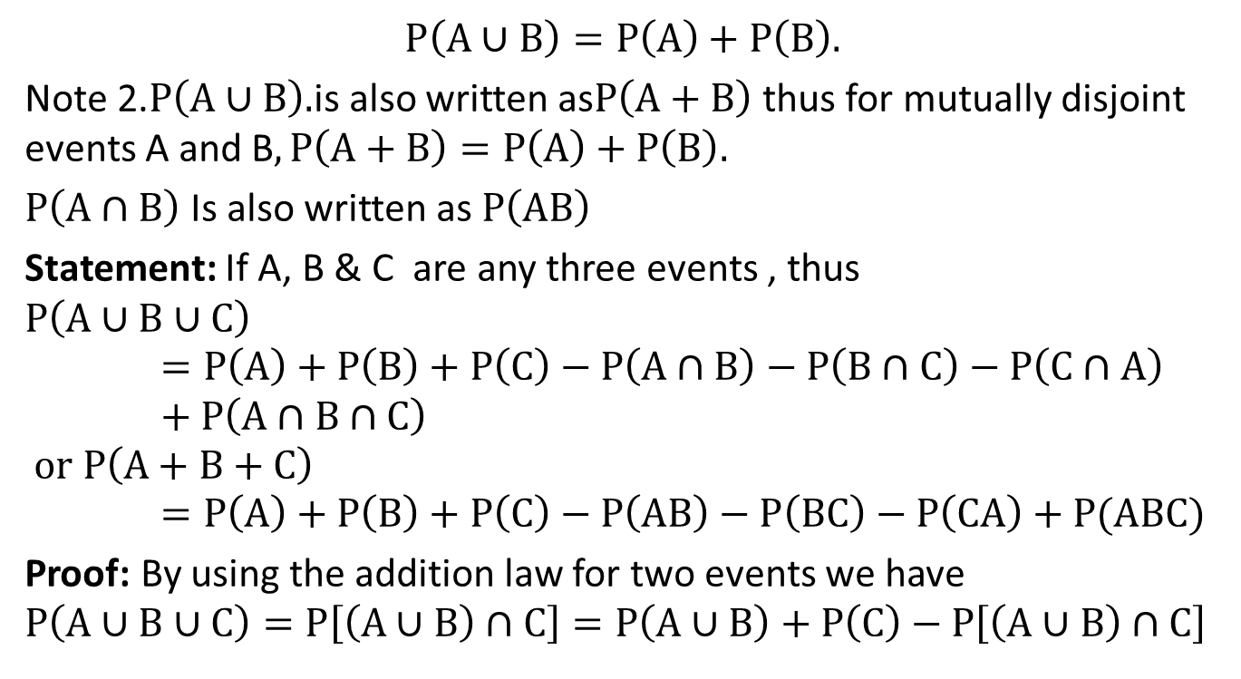
Cont…(CO2)
$$P\left(A∪B\right)=P\left(A\right)+P\left(B\right).$$
Note 2.$P\left(A∪B\right).$is also written as$P\left(A+B\right)$ thus for mutually disjoint events A and B$,P\left(A+B\right)=P\left(A\right)+P\left(B\right).$
$P\left(A∩B\right)$Is also written as $P\left(AB\right)$
Statement: If A, B & C are any three events , thus
$$P\left(A∪B∪C\right)=P\left(A\right)+P\left(B\right)+P\left(C\right)−P\left(A∩B\right)−P\left(B∩C\right)−P\left(C∩A\right)+P\left(A∩B∩C\right)$$
$$or P\left(A+B+C\right)=P\left(A\right)+P\left(B\right)+P\left(C\right)−P\left(AB\right)−P\left(BC\right)−P\left(CA\right)+P(ABC)$$
Proof: By using the addition law for two events we have $P\left(A∪B∪C\right)=P\left[\left(A∪B\right)∩C\right]=P\left(A∪B\right)+P\left(C\right)−P\left[\left(A∪B\right)∩C\right]$
Unit II

Slide 19
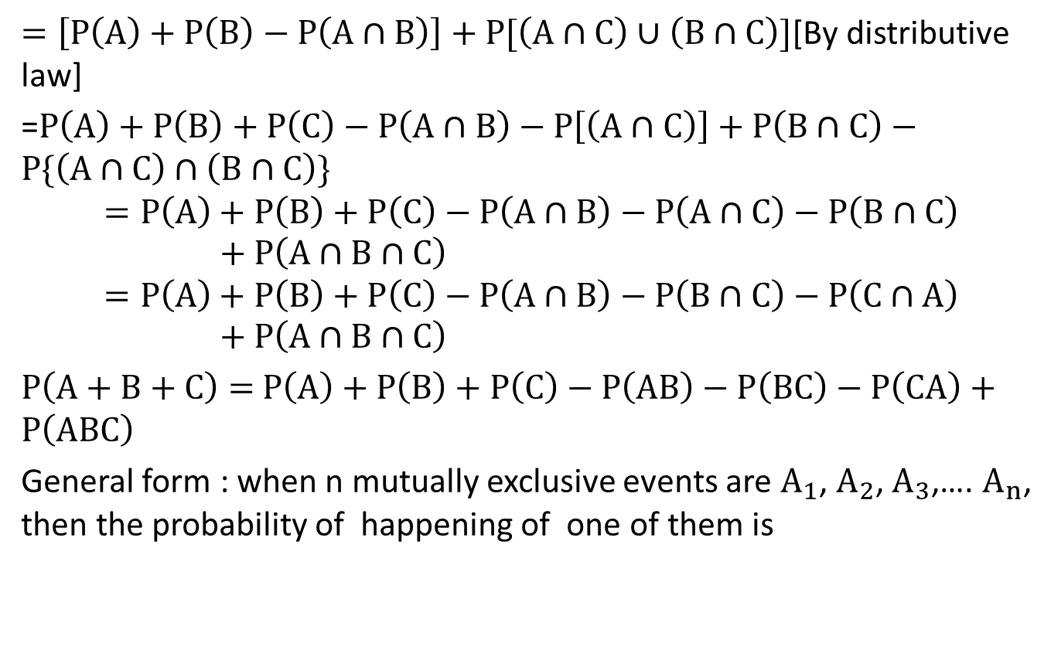
Theorems(CO2)
$=\left[P\left(A\right)+P\left(B\right)−P\left(A∩B\right)\right]+P[\left(A∩C\right)∪\left(B∩C\right)]$[By distributive law]
=$P\left(A\right)+P\left(B\right)+P\left(C\right)−P\left(A∩B\right)−P\left[\left(A∩C\right)\right]+P\left(B∩C\right)−P\{\left(A∩C\right)∩\left(B∩C\right)\}$
$$=P\left(A\right)+P\left(B\right)+P\left(C\right)−P\left(A∩B\right)−P\left(A∩C\right)−P\left(B∩C\right)+P\left(A∩B∩C\right)$$
$$=P\left(A\right)+P\left(B\right)+P\left(C\right)−P\left(A∩B\right)−P\left(B∩C\right)−P\left(C∩A\right)+P\left(A∩B∩C\right)$$
$$P\left(A+B+C\right)=P\left(A\right)+P\left(B\right)+P\left(C\right)−P\left(AB\right)−P\left(BC\right)−P\left(CA\right)+P\left(ABC\right)$$
General form : when n mutually exclusive events are $A_{1}$,$A_{2}$,$A_{3}$,….$A_{n}$, then the probability of happening of one of them is
Unit II

Slide 20
Daily Quiz(CO2)
In a class of 10 students, 4 are boys and the rest are girls. Find the Probability that a student selected will be a girl. Ans: 3/5
2. A speaks truth in 60% cases and B in 70% cases. In what % of cases are they likely to contradict each other in stating the same fact?
Ans: 46%
Unit II

Slide 21
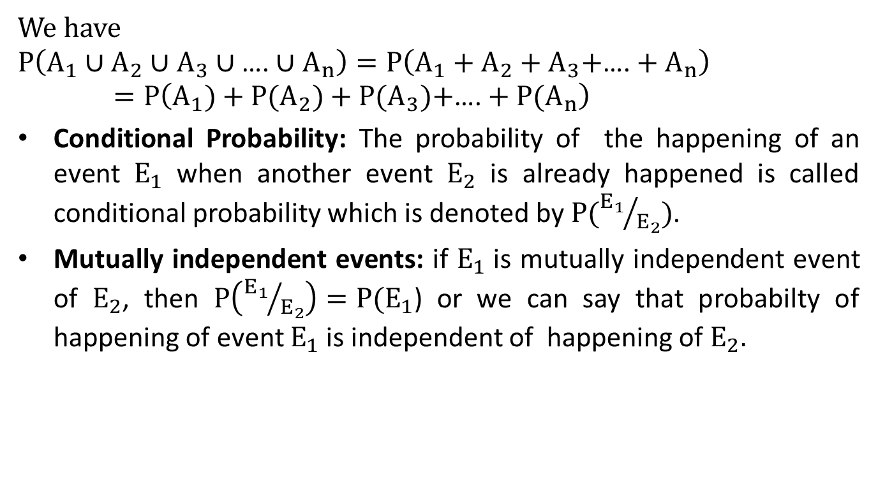
Multiplicative Law of Probability(CO2)
We have
$$P\left(A_{1}∪A_{2}∪A_{3}∪\text{….}∪A_{n}\right)=P\left(A_{1}+A_{2}+A_{3}\text{+}\text{….}+A_{n}\right)=P\left(A_{1})+P(A_{2})+P(A_{3})\text{+}\text{….}+P(A_{n}\right)$$
Conditional Probability: The probability of the happening of an event $E_{1}$when another event $E_{2}$ is already happened is called conditional probability which is denoted by $P({E_{1}}/{E_{2}})$.
Mutually independent events: if $E_{1}$is mutually independent event of $E_{2}$, then $P\left({E_{1}}/{E_{2}}\right)=P(E_{1}$) or we can say that probabilty of happening of event $E_{1}$ is independent of happening of $E_{2}.$
Unit II

Slide 22
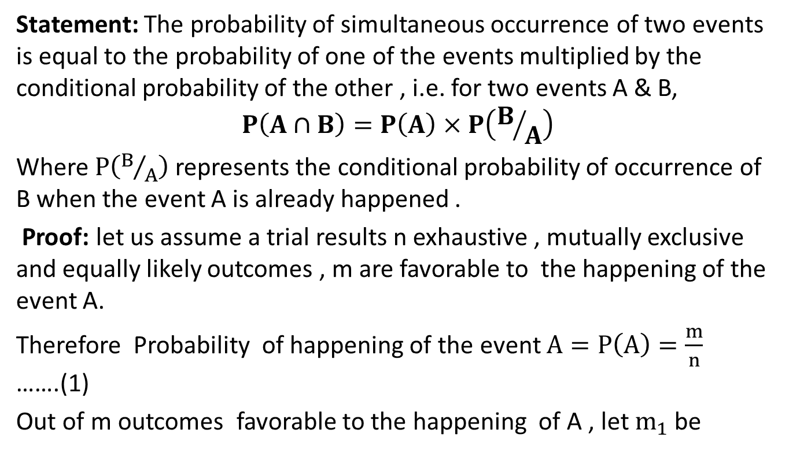
Multiplicative Law of Probability(CO2)
Statement: The probability of simultaneous occurrence of two events is equal to the probability of one of the events multiplied by the conditional probability of the other , i.e. for two events A & B,
$$P\left(A∩B\right)=P\left(A\right)×P\left(B/A\right)$$
Where $P\left(B/A\right)$ represents the conditional probability of occurrence of B when the event A is already happened .
Proof: let us assume a trial results n exhaustive , mutually exclusive and equally likely outcomes , m are favorable to the happening of the event A.
Therefore Probability of happening of the event $A=P\left(A\right)=\frac{m}{n}$ …….(1)
Out of m outcomes favorable to the happening of A , let $m_{1}$ be
Unit II

Slide 23
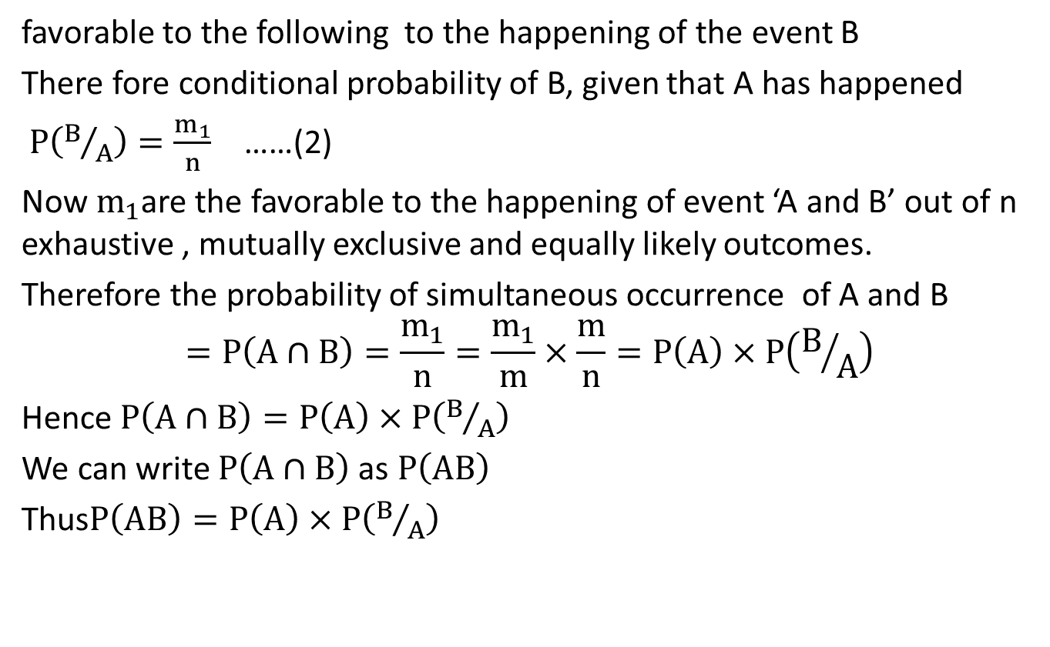
Multiplicative Law of Probability(CO2)
favorable to the following to the happening of the event B
There fore conditional probability of B, given that A has happened
$P\left(B/A\right)=\frac{m_{1}}{n}$ ……(2)
Now $m_{1}$are the favorable to the happening of event ‘A and B’ out of n exhaustive , mutually exclusive and equally likely outcomes.
Therefore the probability of simultaneous occurrence of A and B
$$=P\left(A∩B\right)=\frac{m_{1}}{n}=\frac{m_{1}}{m}×\frac{m}{n}=P\left(A\right)×P\left(B/A\right)$$
Hence $P\left(A∩B\right)=P\left(A\right)×P\left(B/A\right)$
We can write $P\left(A∩B\right)$ as $P\left(AB\right)$
Thus$P\left(AB\right)=P\left(A\right)×P\left(B/A\right)$
Unit II

Slide 24
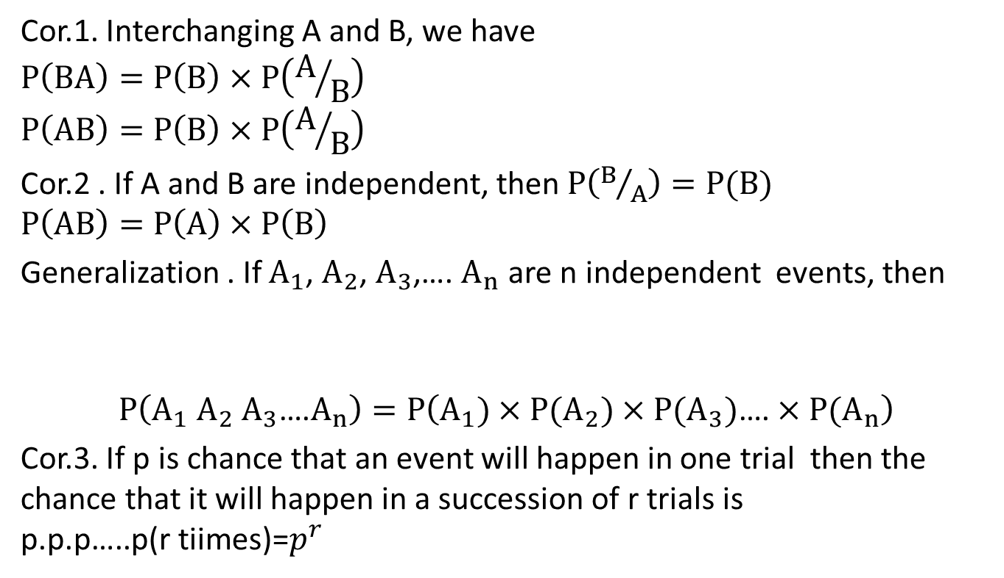
Multiplicative Law of Probability(CO2)
Cor.1. Interchanging A and B, we have
$$P\left(BA\right)=P\left(B\right)×P\left(A/B\right)$$
$$P\left(AB\right)=P\left(B\right)×P\left(A/B\right)$$
Cor.2 . If A and B are independent, then $P\left(B/A\right)=P(B)$
$$P\left(AB\right)=P\left(A\right)×P\left(B\right)$$
Generalization . If $A_{1}$, $A_{2}$, $A_{3}$,…. $A_{n}$ are n independent events, then
$$P\left(A_{1} A_{2} A_{3}\text{….}A_{n}\right)=P\left(A_{1})×P(A_{2})×P(A_{3})\text{….}×P(A_{n}\right)$$
Cor.3. If p is chance that an event will happen in one trial then the chance that it will happen in a succession of r trials is
$$\text{p}\text{.}\text{p}\text{.}\text{p}\text{…..}\text{p}\text{(}\text{r} \text{tiimes}\text{)=}p^{r}$$
Unit II

Slide 25
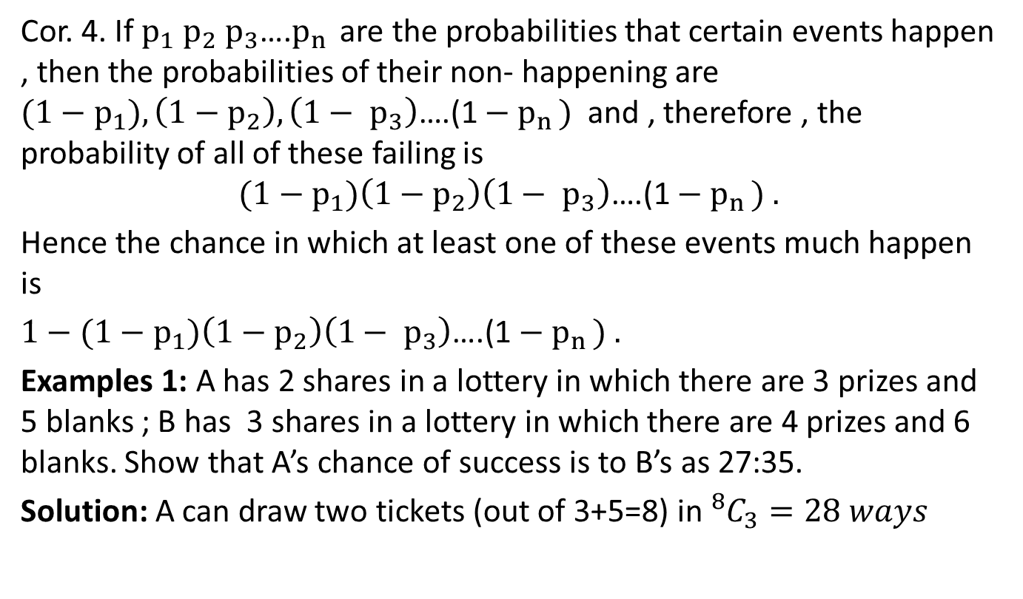
Multiplicative Law of Probability(CO2)
Cor. 4. If $p_{1} p_{2} p_{3}\text{….}p_{n }$ are the probabilities that certain events happen , then the probabilities of their non- happening are ${(1−p}_{1}), \left(1−p_{2}\right),\left(1− p_{3}\right)\text{….(1}−p_{n })$ and , therefore , the probability of all of these failing is
$${(1−p}_{1})\left(1−p_{2}\right)\left(1− p_{3}\right)\text{….(1}−p_{n }) .$$
Hence the chance in which at least one of these events much happen is
$$1−{(1−p}_{1})\left(1−p_{2}\right)\left(1− p_{3}\right)\text{….(1}−p_{n }) .$$
Examples 1: A has 2 shares in a lottery in which there are 3 prizes and 5 blanks ; B has 3 shares in a lottery in which there are 4 prizes and 6 blanks. Show that A’s chance of success is to B’s as 27:35.
Solution: A can draw two tickets (out of 3+5=8) in ${}_{}^{8}{C_{3}=28 ways}$
Unit II

Slide 26
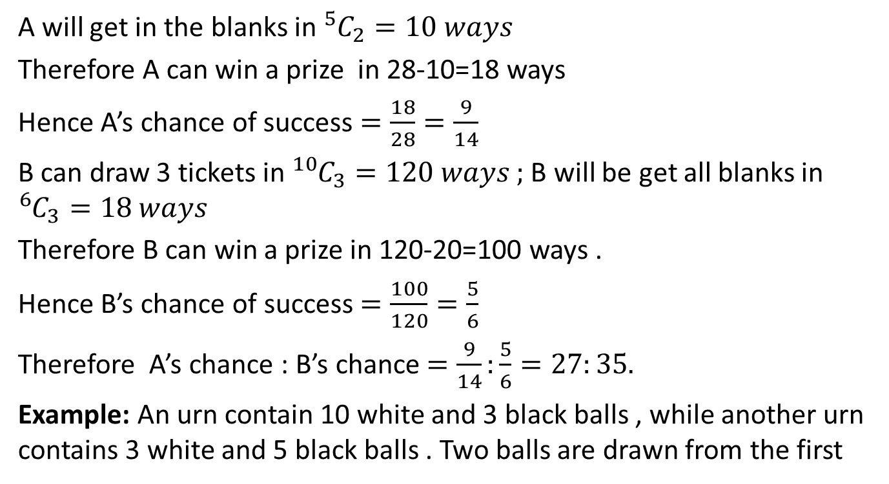
Question’s Based on Multiplicative Law(CO2)
A will get in the blanks in ${}_{}^{5}{C_{2}=10 ways }$
Therefore A can win a prize in 28-10=18 ways
Hence A’s chance of success $=\frac{18}{28}=\frac{9}{14}$
B can draw 3 tickets in ${}_{}^{10}{C_{3}=120 ways ; }$B will be get all blanks in ${}_{}^{6}{C_{3}=18 ways }$
Therefore B can win a prize in 120-20=100 ways .
Hence B’s chance of success $=\frac{100}{120}=\frac{5}{6}$
Therefore A’s chance : B’s chance $=\frac{9}{14}:\frac{5}{6}=27:35.$
Example: An urn contain 10 white and 3 black balls , while another urn contains 3 white and 5 black balls . Two balls are drawn from the first
Unit II

Slide 27
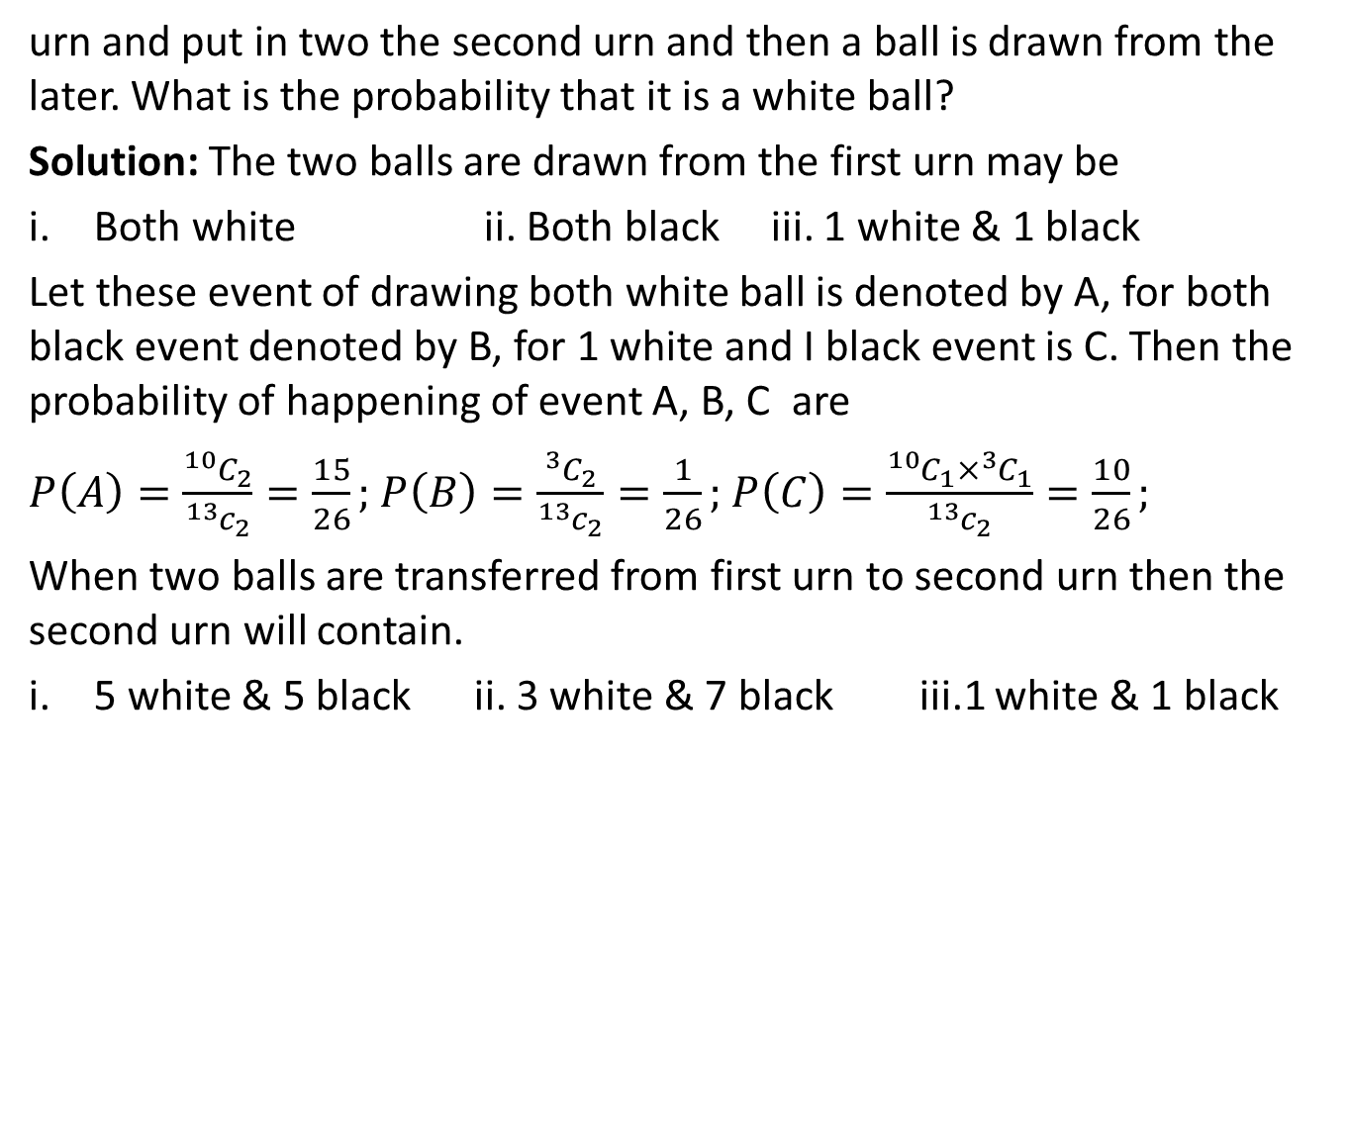
Question’s Based on Multiplicative Law(CO2)
urn and put in two the second urn and then a ball is drawn from the later. What is the probability that it is a white ball?
Solution: The two balls are drawn from the first urn may be
Both white ii. Both black iii. 1 white & 1 black
Let these event of drawing both white ball is denoted by A, for both black event denoted by B, for 1 white and I black event is C. Then the probability of happening of event A, B, C are
$$P\left(A\right)=\frac{{}_{}^{10}{C_{2}}}{{}_{}^{13}{c_{2}}}=\frac{15}{26};P\left(B\right)=\frac{{}_{}^{3}{C_{2}}}{{}_{}^{13}{c_{2}}}=\frac{1}{26};P\left(C\right)=\frac{{}_{}^{10}{C_{1}×{}_{}^{3}{C_{1}}}}{{}_{}^{13}{c_{2}}}=\frac{10}{26};$$
When two balls are transferred from first urn to second urn then the second urn will contain.
5 white &5 black ii. 3white &7 black iii.1 white & 1 black
Unit II

Slide 28
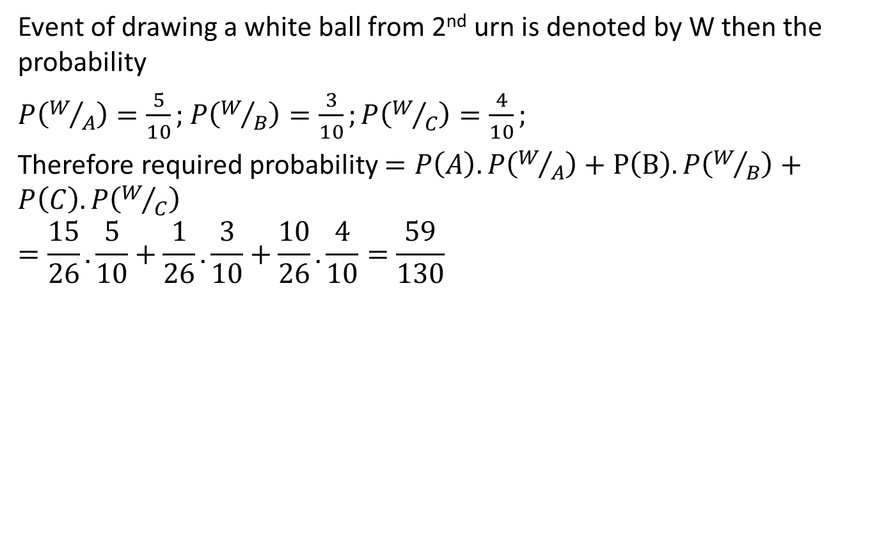
Question’s Based on Multiplicative Law(CO2)
Event of drawing a white ball from 2nd urn is denoted by W then the probability
$$P\left(W/A\right)=\frac{5}{10};P\left(W/B\right)=\frac{3}{10};P\left(W/C\right)=\frac{4}{10};$$
Therefore required probability $=P\left(A\right).P\left(W/A\right)+P\left(B\right).P\left(W/B\right)+P\left(C\right).P\left(W/C\right)$
$$=\frac{15}{26}.\frac{5}{10}+\frac{1}{26}.\frac{3}{10}+\frac{10}{26}.\frac{4}{10}=\frac{59}{130}$$
Unit II

Slide 29
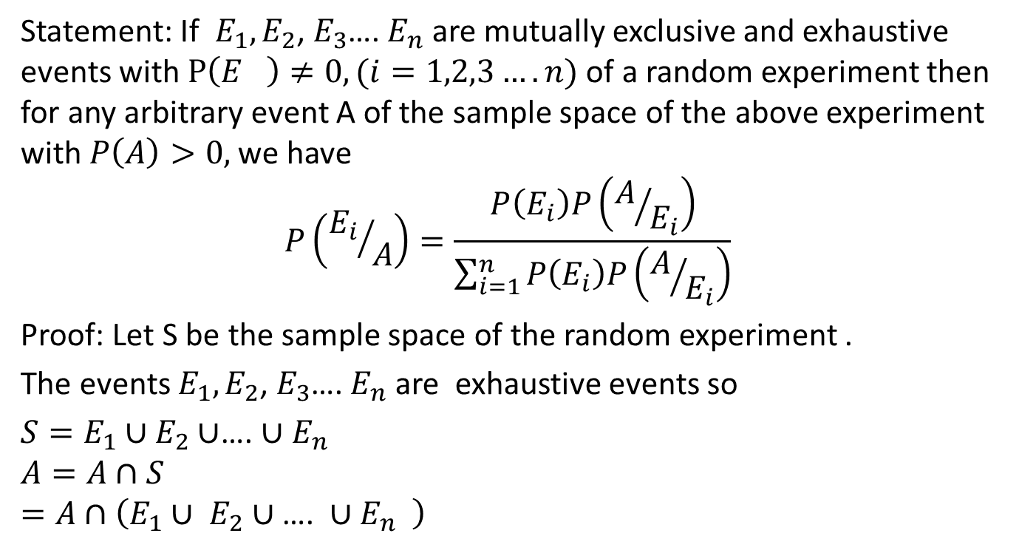
Bayes’ Theorem(CO2)
Statement: If $E_{1},E_{2}$,$E_{3}$….$E_{n}$ are mutually exclusive and exhaustive events with$P\left(E_{}\right)≠0,(i=1,2,3….n)$ of a random experiment then for any arbitrary event A of the sample space of the above experiment with $P\left(A\right)>0,$ we have
$$P\left({E_{i}}/A\right)=\frac{P\left(E_{i}\right)P\left(A/{E_{i}}\right)}{\sum_{i=1}^{n}{P\left(E_{i}\right)P\left(A/{E_{i}}\right)}}$$
Proof: Let S be the sample space of the random experiment .
The events $E_{1},E_{2}$, $E_{3}$…. $E_{n}$ are exhaustive events so
${S=E}_{1}∪E_{2}∪$…. ${∪E}_{n}$
$$A=A∩S$$
$$=A∩\left(E_{1}∪ E_{2}∪\text{…. }{∪E}_{n} \right)$$
Unit II

Slide 30
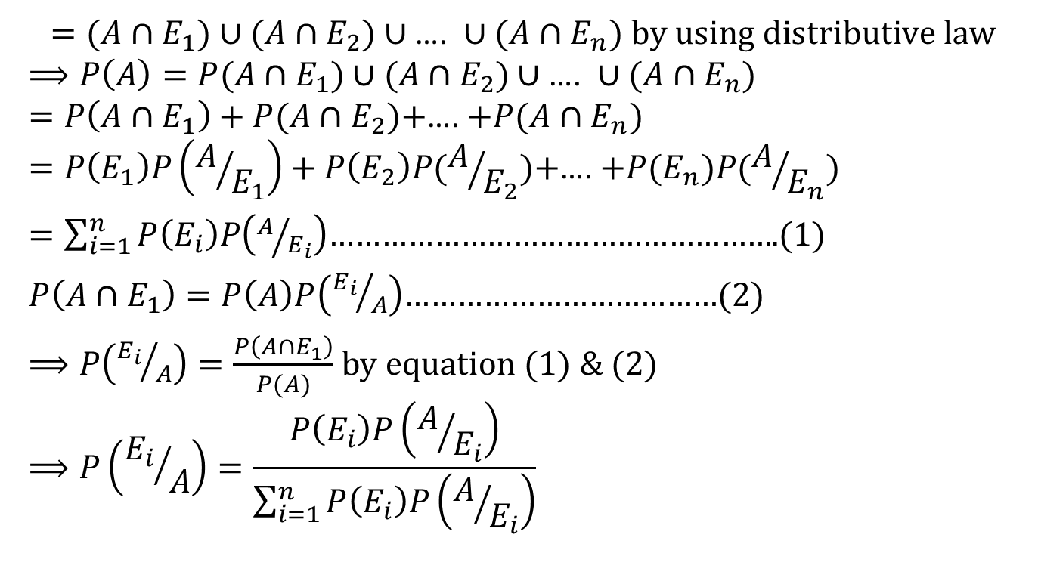
Topic(CO2)
$$=(A∩E_{1})∪(A∩E_{2})∪\text{…. }{∪(A∩E}_{n}) \text{by} \text{using} \text{distributive} \text{law}$$
$$⟹P\left(A\right)=P(A∩E_{1})∪(A∩E_{2})∪\text{…. }{∪(A∩E}_{n})$$
$$=P\left(A∩E_{1}\right)+P(A∩E_{2})\text{+}\text{…. }{+P(A∩E}_{n})$$
$$=P\left(E_{1}\right)P\left(A/{E_{1}}\right)+P\left(E_{2}\right)P(A/{E_{2}})\text{+}\text{…. }{+P(E}_{n})P(A/{E_{n}})$$
$=\sum_{i=1}^{n}{P\left(E_{i}\right)P\left(A/{E_{i}}\right)}$…………………………………………….(1)
$P\left(A∩E_{1}\right)=P\left(A\right)P\left({E_{i}}/A\right)$………………………………(2)
$⟹P\left({E_{i}}/A\right)=\frac{P\left(A∩E_{1}\right)}{P(A)}$ by equation (1) & (2)
$$⟹P\left({E_{i}}/A\right)=\frac{P\left(E_{i}\right)P\left(A/{E_{i}}\right)}{\sum_{i=1}^{n}{P\left(E_{i}\right)P\left(A/{E_{i}}\right)}}$$
Unit II

Slide 31
Random Variable(CO2)
Definition: A particular value which cannot be predicated in advance then the value is called random variable.
There are two types of Random Variable.
Discrete Random variable: isolated values is known as discrete random variables.
Example: By tossing a coin 4 times, the number of Heads come up then the value of random variables are 0,1,2,3,4.
Continuous Random Variable: which variables can assume any value within interval is called continuous .
Example : the heights of a group of individuals, Weight of the students in a class etc.
Unit II

Slide 32

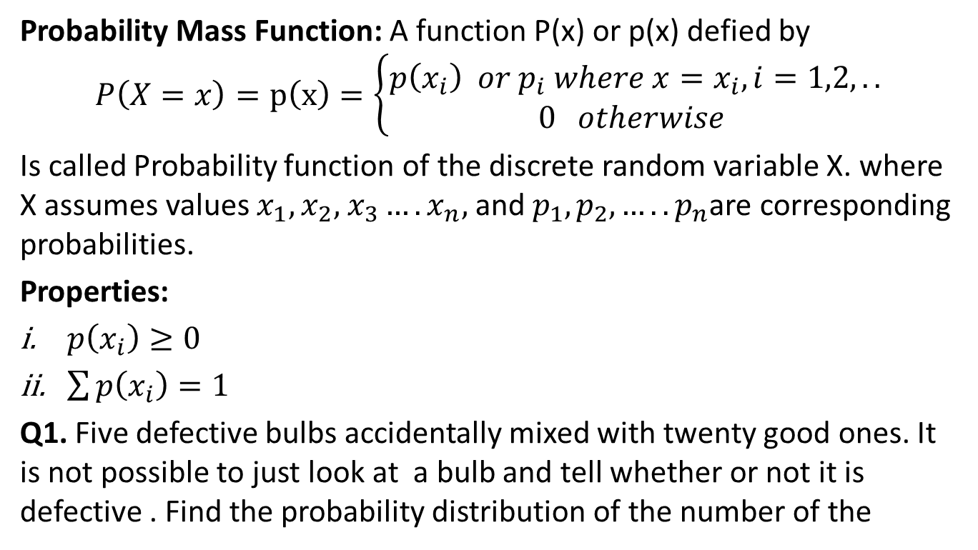
Probability Mass Function(CO2)
Probability Mass Function: A function P(x) or p(x) defied by
$$P\left(X=x\right)=p\left(x\right)=\left\{\begin{matrix}p\left(x_{i}\right) or p_{i} where x=x_{i},i=1,2,.. \\ 0 otherwise \end{matrix}\right.$$
Is called Probability function of the discrete random variable X. where X assumes values $x_{1},x_{2},$ $x_{3}….x_{n},$ and $p_{1},p_{2}, …..p_{n}$are corresponding probabilities.
Properties:
$p\left(x_{i}\right)≥0$
$\sum{p\left(x_{i}\right)=1}$
Q1. Five defective bulbs accidentally mixed with twenty good ones. It is not possible to just look at a bulb and tell whether or not it is defective . Find the probability distribution of the number of the

Slide 33
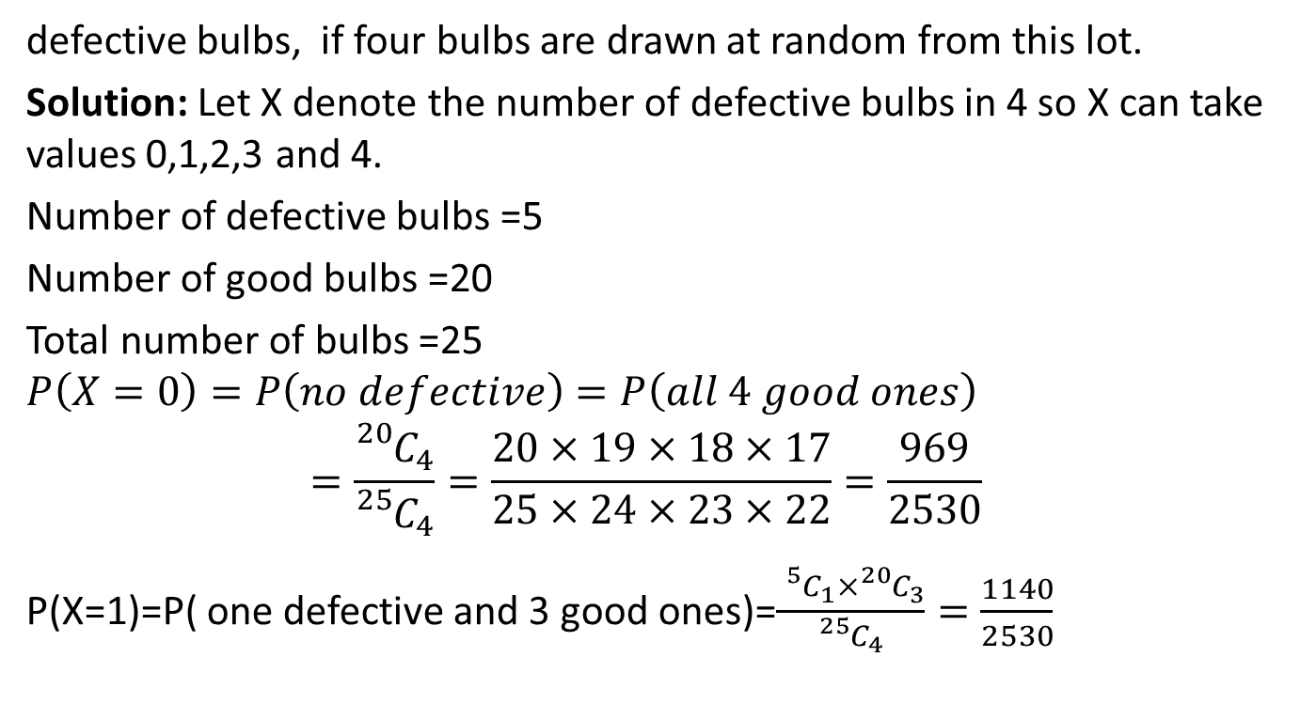
Probability Mass Function(CO2)
defective bulbs, if four bulbs are drawn at random from this lot.
Solution: Let X denote the number of defective bulbs in 4 so X can take values 0,1,2,3 and 4.
Number of defective bulbs =5
Number of good bulbs =20
Total number of bulbs =25
$$P\left(X=0\right)=P\left(no defective\right)=P\left(all 4 good ones\right)$$
$$=\frac{{}_{}^{20}{C_{4}}}{{}_{}^{25}{C_{4}}}=\frac{20×19×18×17}{25×24×23×22}=\frac{969}{2530}$$
P(X=1)=P( one defective and 3 good ones)=$\frac{{}_{}^{5}{C_{1}}×{}_{}^{20}{C_{3}}}{{}_{}^{25}{C_{4}}}=\frac{1140}{2530}$

Slide 34
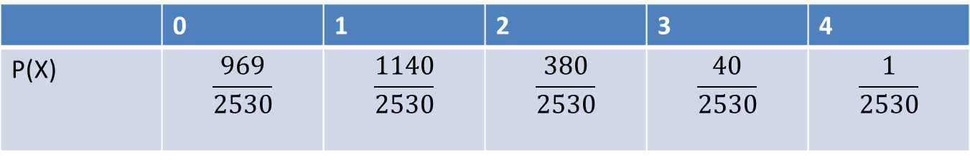
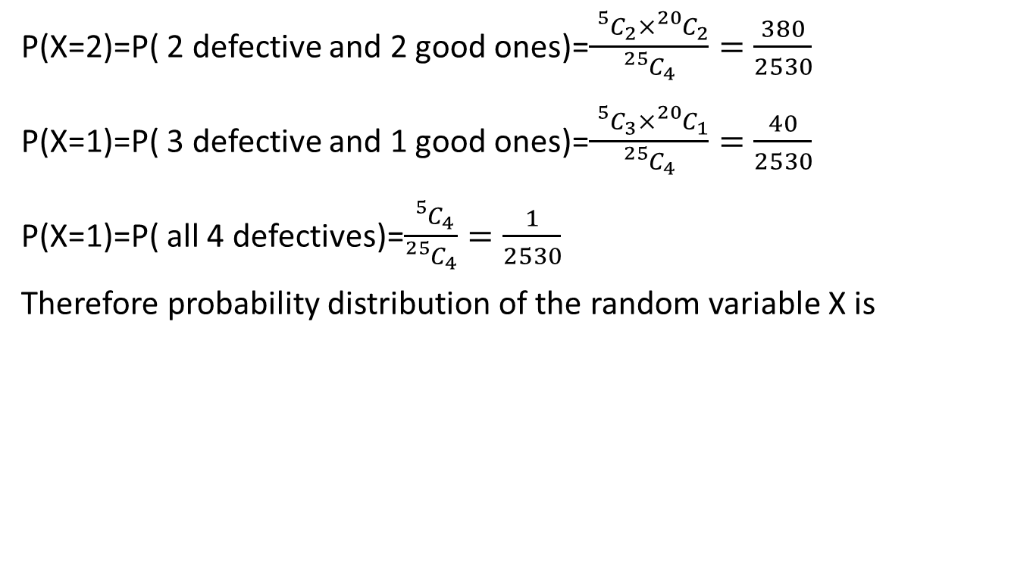
Probability Mass Function(CO2)
P(X=2)=P( 2 defective and 2 good ones)=$\frac{{}_{}^{5}{C_{2}}×{}_{}^{20}{C_{2}}}{{}_{}^{25}{C_{4}}}=\frac{380}{2530}$
P(X=1)=P( 3 defective and 1 good ones)=$\frac{{}_{}^{5}{C_{3}}×{}_{}^{20}{C_{1}}}{{}_{}^{25}{C_{4}}}=\frac{40}{2530}$
P(X=1)=P( all 4 defectives)=$\frac{{}_{}^{5}{C_{4}}}{{}_{}^{25}{C_{4}}}=\frac{1}{2530}$
Therefore probability distribution of the random variable X is

Slide 35
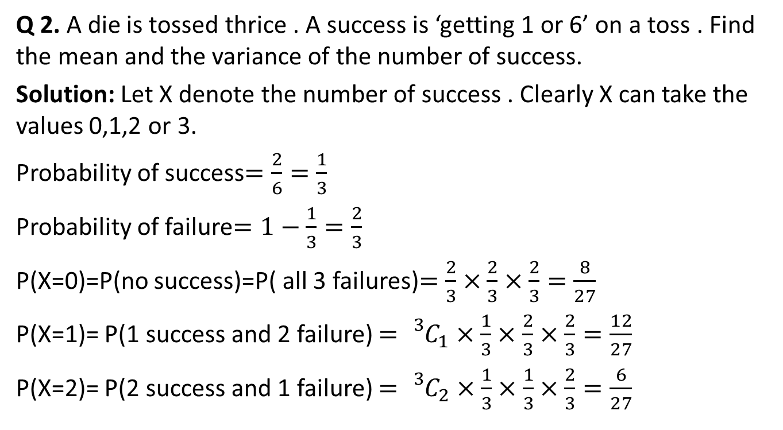
Probability Mass Function(CO2)
Q 2. A die is tossed thrice . A success is ‘getting 1 or 6’ on a toss . Find the mean and the variance of the number of success.
Solution: Let X denote the number of success . Clearly X can take the values 0,1,2 or 3.
Probability of success$=\frac{2}{6}=\frac{1}{3}$
Probability of failure$=1−\frac{1}{3}=\frac{2}{3}$
P(X=0)=P(no success)=P( all 3 failures)$=\frac{2}{3}×$ $\frac{2}{3}×\frac{2}{3}=\frac{8}{27}$
P(X=1)= P(1 success and 2 failure) $={}_{}^{3}{C_{1}×}\frac{1}{3}×$ $\frac{2}{3}×\frac{2}{3}=\frac{12}{27}$
P(X=2)= P(2 success and 1 failure) $={}_{}^{3}{C_{2}×}\frac{1}{3}×$ $\frac{1}{3}×\frac{2}{3}=\frac{6}{27}$

Slide 36
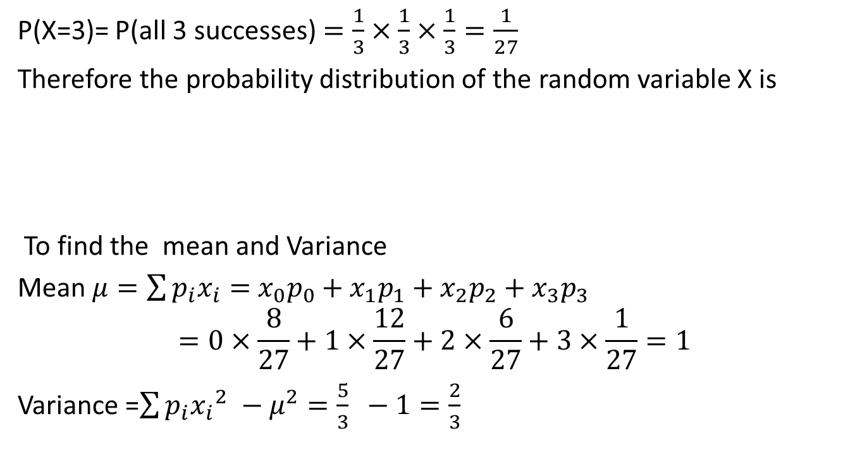
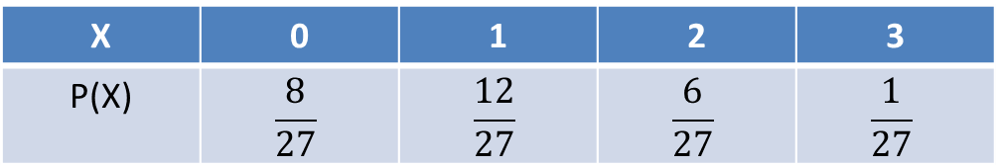
Probability Mass Function(CO2)
P(X=3)= P(all 3 successes) $=\frac{1}{3}×$ $\frac{1}{3}×\frac{1}{3}=\frac{1}{27}$
Therefore the probability distribution of the random variable X is
To find the mean and Variance
Mean $μ=\sum{p_{i}x_{i}=}$ ${x_{0}p_{0}+x}_{1}p_{1}+x_{2}p_{2}+x_{3}p_{3}$
$$=0×\frac{8}{27}+1×\frac{12}{27}+2×\frac{6}{27}+3×\frac{1}{27}=1$$
Variance =$\sum{p_{i}{x_{i}}_{}^{2}−μ^{2}=\frac{5}{3} −1=\frac{2}{3} }$
X | 0 | 1 | 2 | 3
P(X) | $$\frac{8}{27}$$ | $$\frac{12}{27}$$ | $$\frac{6}{27}$$ | $$\frac{1}{27}$$

Slide 37
Continuous Random Variables(CO2)
Continuous Random Variable: Which variables can assume any value within interval is called continuous .
Example : The heights of a group of individuals.

Slide 38
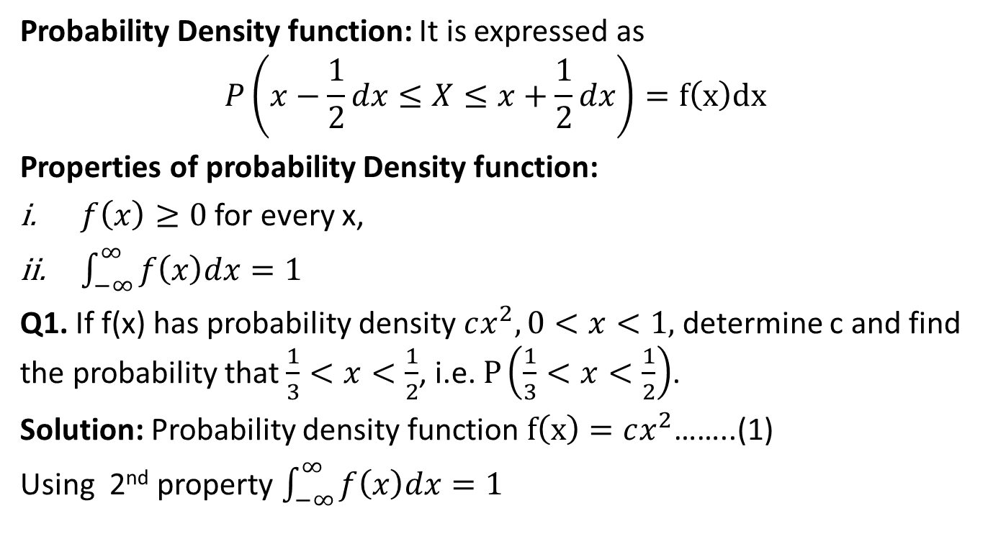
Probability Density function(CO2)
Probability Density function: It is expressed as
$$P\left(x−\frac{1}{2}dx≤X≤x+\frac{1}{2}dx\right)=f\left(x\right)dx$$
Properties of probability Density function:
$f\left(x\right)≥0$ for every x,
$\int_{−∞}^{∞}{f\left(x\right)dx=1}$
Q1. If f(x) has probability density $cx^{2},0<x<1,$ determine c and find the probability that $\frac{1}{3}<x<\frac{1}{2}$, i.e. $P\left(\frac{1}{3}<x<\frac{1}{2}\right)$.
Solution: Probability density function $f\left(x\right)=cx^{2}$……..(1)
Using 2nd property $\int_{−∞}^{∞}{f\left(x\right)dx=1}$

Slide 39

Probability Density function(CO2)
We have
$\int_{0}^{1}{cx^{2}=1}$
$$⟹\frac{1}{3}{{\left[cx^{3}\right]}^{1}}_{0}^{}=1$$
$$⟹c=3$$
$$P\left(\frac{1}{3}<x<\frac{1}{2}\right)=\int_{1/3}^{1/2}{3x^{2}=\frac{19}{216}}$$

Slide 40
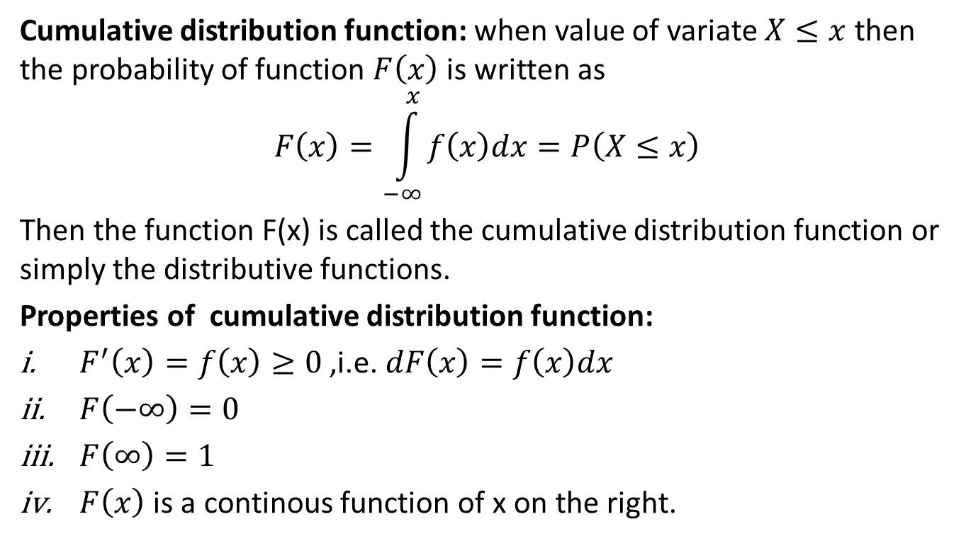
Cumulative distribution function(CO2)
Cumulative distribution function: when value of variate $X≤x$then the probability of function $F\left(x\right)$ is written as
$$F\left(x\right)=\int_{−∞}^{x}{f\left(x\right)dx}=P\left(X≤x\right)$$
Then the function F(x) is called the cumulative distribution function or simply the distributive functions.
Properties of cumulative distribution function:
$F^{′}\left(x\right)=f\left(x\right)≥0$ ,i.e. $dF\left(x\right)=f\left(x\right)dx$
$F\left(−∞\right)=0$
$F\left(∞\right)=1$
$F\left(x\right)$ is a continous function of x on the right.

Slide 41
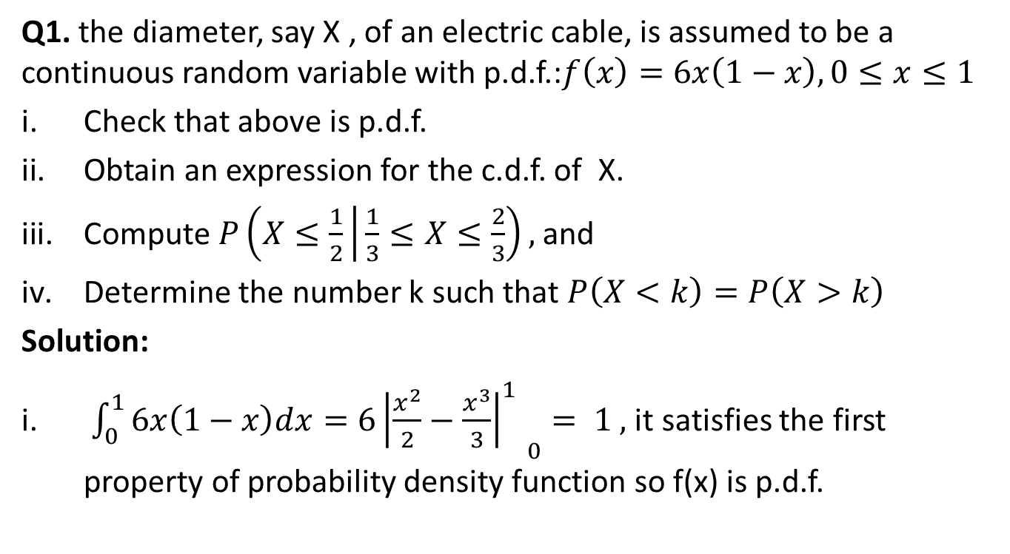
Cumulative distribution function(CO2)
Q1. the diameter, say X , of an electric cable, is assumed to be a continuous random variable with p.d.f.:$f\left(x\right)=6x\left(1−x\right),0≤x≤1$
Check that above is p.d.f.
Obtain an expression for the c.d.f. of X.
Compute $P\left(X≤\frac{1}{2} | \frac{1}{3}≤X≤\frac{2}{3}\right),$and
Determine the number k such that $P\left(X<k\right)=P\left(X>k\right)$
Solution:
$\int_{0}^{1}{6x\left(1−x\right)dx=6{{\left|\frac{x^{2}}{2}−\frac{x^{3}}{3}\right|}_{}^{1}}_{0}}= 1 ,$it satisfies the first property of probability density function so f(x) is p.d.f.

Slide 42
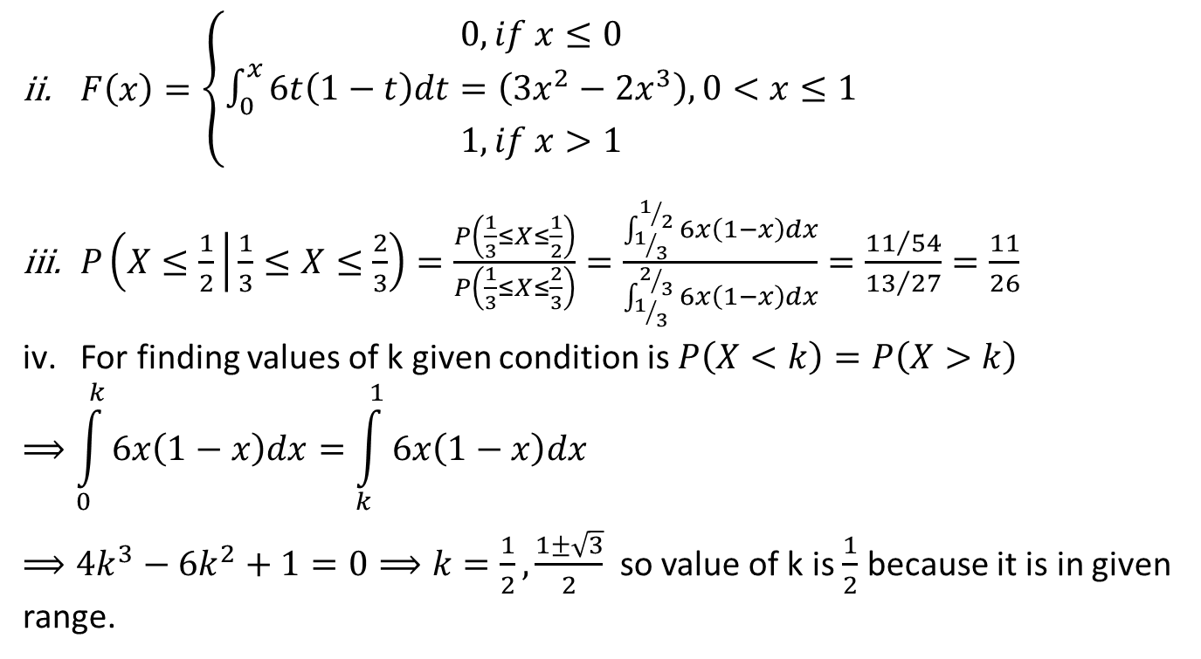
Cumulative distribution function(CO2)
$F\left(x\right)=\left\{\begin{matrix}0, if x≤0 \\ \int_{0}^{x}{6t\left(1−t\right)dt=\left(3x^{2}−2x^{3}\right),0<x≤1} \\ 1, if x>1\end{matrix}\right.$
$P\left(X≤\frac{1}{2} | \frac{1}{3}≤X≤\frac{2}{3}\right)=\frac{P\left(\frac{1}{3}≤X≤\frac{1}{2}\right)}{P\left(\frac{1}{3}≤X≤\frac{2}{3}\right)}=\frac{\int_{1/3}^{1/2}{6x\left(1−x\right)dx}}{\int_{1/3}^{2/3}{6x\left(1−x\right)dx}}=\frac{{11}/{54}}{{13}/{27}}=\frac{11}{26}$
For finding values of k given condition is $P\left(X<k\right)=P\left(X>k\right)$
$$⟹\int_{0}^{k}{6x\left(1−x\right)dx=\int_{k}^{1}{6x\left(1−x\right)dx}}$$
$⟹4k^{3}−6k^{2}+1=0⟹k=\frac{1}{2},\frac{1±\sqrt{3}}{2}$ so value of k is $\frac{1}{2}$ because it is in given range.

Slide 43
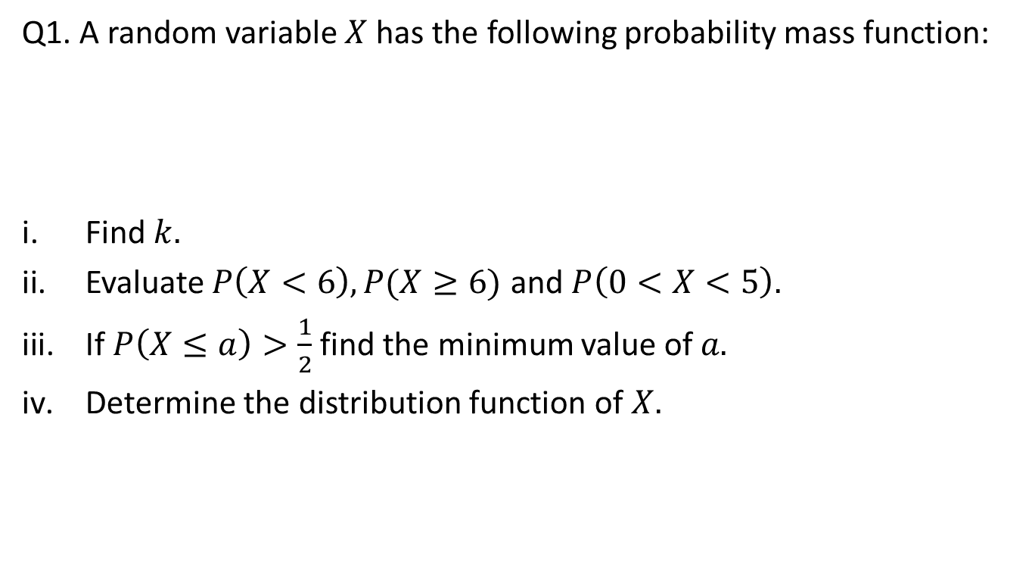
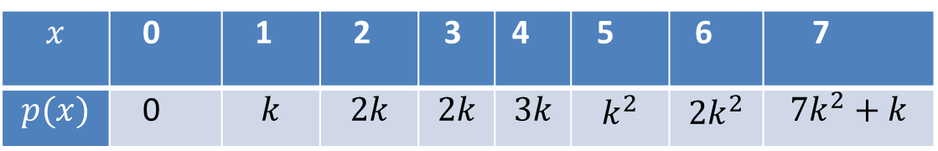
Daily Quiz(CO2)
Q1. A random variable $X$ has the following probability mass function:
Find $k.$
Evaluate $P\left(X<6\right),P(X≥6)$ and $P\left(0<X<5\right).$
If $P\left(X≤a\right)>\frac{1}{2}$ find the minimum value of $a.$
Determine the distribution function of $X.$
$$x$$ | 0 | 1 | 2 | 3 | 4 | 5 | 6 | 7
$$p(x)$$ | 0 | $$k$$ | $$2k$$ | $$2k$$ | $$3k$$ | $$k^{2}$$ | $${2k}^{2}$$ | $${7k}^{2}+k$$

Slide 44
Recap(CO2)
Probability
Conditional probability
Baye’s Theorem
Random Variables
Probability Density function
Probability mass function

Slide 45
Topic objective (CO2)
Mathematical expectation
To get a general understanding of the mathematical expectation of a discrete random variable.
To learn and be able to apply a shortcut formula for the variance of a discrete random variable.
To be able to calculate the mean and variance of a linear function of a discrete random variable.

Slide 46
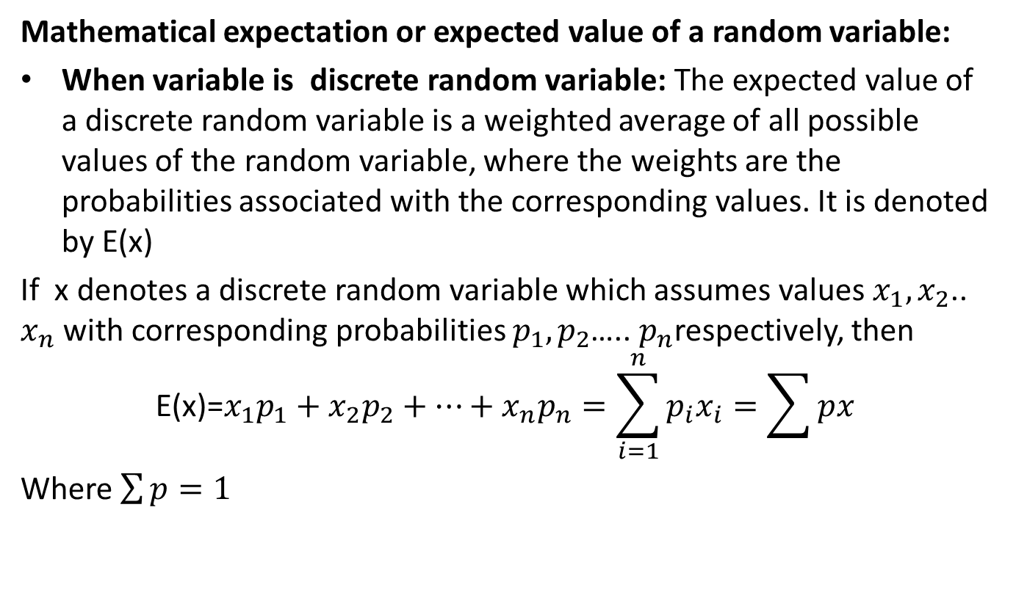
Mathematical expectation(CO2)
Mathematical expectation or expected value of a random variable:
When variable is discrete random variable: The expected value of a discrete random variable is a weighted average of all possible values of the random variable, where the weights are the probabilities associated with the corresponding values. It is denoted by E(x)
If x denotes a discrete random variable which assumes values $x_{1},x_{2}$.. $x_{n}$ with corresponding probabilities $p_{1},p_{2}$….. $p_{n}$respectively, then
$$\text{E}\text{(}\text{x}\text{)=}x_{1}p_{1}+{x_{2}p}_{2}+…+x_{n}p_{n}=\sum_{i=1}^{n}{p_{i}x_{i}}=\sum{px}$$
Where $\sum{p}=1$

Slide 47
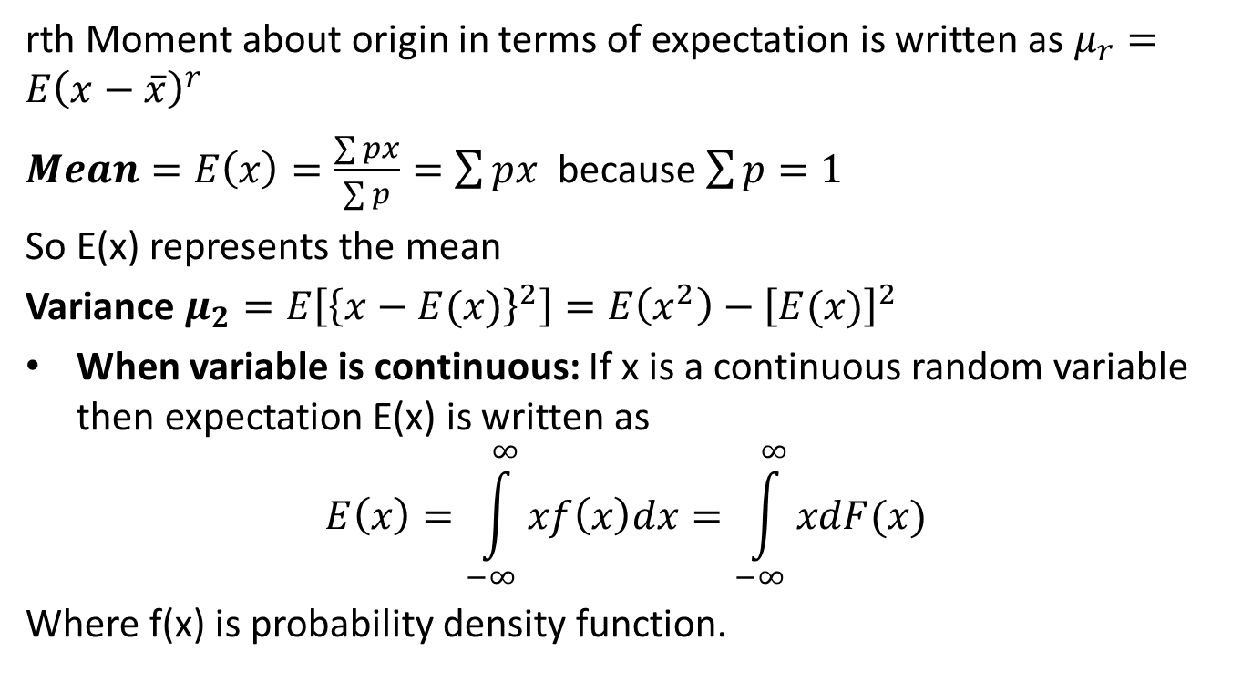
Mathematical expectation(CO2)
rth Moment about origin in terms of expectation is written as $μ_{r}=E{\left(x−\overline{x}\right)}^{r}$
$Mean=E\left(x\right)=\frac{\sum{px}}{\sum{p}}=\sum{px}$ because $\sum{p=1}$
So E(x) represents the mean
Variance $μ_{2}=E\left[{\left\{x−E(x)\right\}}^{2}\right]=E\left(x^{2}\right)−{\left[E(x)\right]}^{2}$
When variable is continuous: If x is a continuous random variable then expectation E(x) is written as
$$E\left(x\right)=\int_{−∞}^{∞}{xf\left(x\right)dx=\int_{−∞}^{∞}{xdF(x)}}$$
Where f(x) is probability density function.

Slide 48
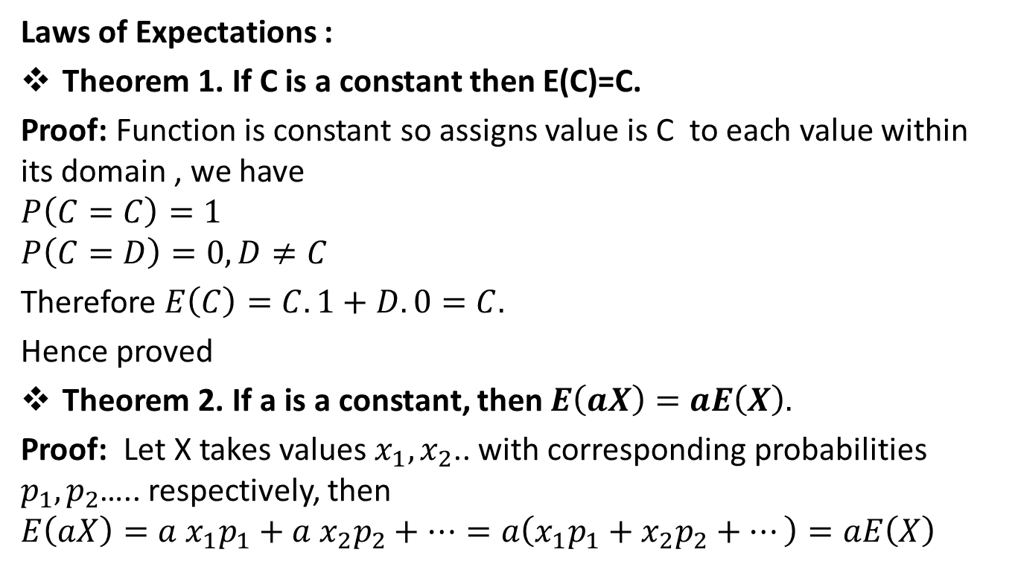
Mathematical expectation(CO2)
Laws of Expectations :
Theorem 1. If C is a constant then E(C)=C.
Proof: Function is constant so assigns value is C to each value within its domain , we have
$$P\left(C=C\right)=1$$
$$P\left(C=D\right)=0, D≠C$$
Therefore $E\left(C\right)=C.1+D.0=C.$
Hence proved
Theorem 2. If a is a constant, then $E\left(aX\right)=aE\left(X\right).$
Proof: Let X takes values $x_{1},x_{2}$.. with corresponding probabilities $p_{1},p_{2}$….. respectively, then
$$E\left(aX\right)={a x}_{1}p_{1}+{a{ x}_{2}p}_{2}+…=a\left(x_{1}p_{1}+{x_{2}p}_{2}+…\right)=aE\left(X\right)$$

Slide 49
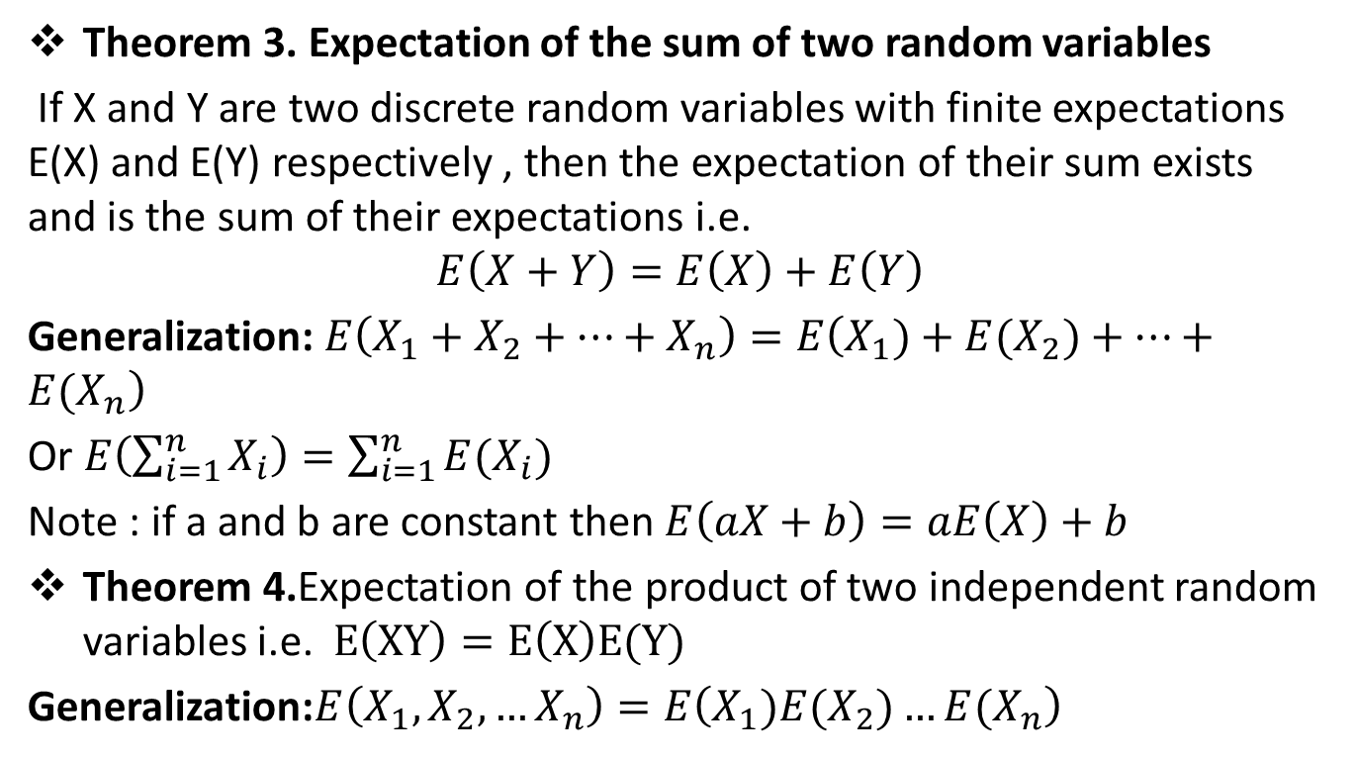
Mathematical expectation(CO2)
Theorem 3. Expectation of the sum of two random variables
If X and Y are two discrete random variables with finite expectations E(X) and E(Y) respectively , then the expectation of their sum exists and is the sum of their expectations i.e.
$$E\left(X+Y\right)=E\left(X\right)+E\left(Y\right)$$
Generalization: $E\left(X_{1}+X_{2}+…+X_{n}\right)=E\left(X_{1})+{E(X}_{2})+…+E(X_{n}\right)$
Or $E\left(\sum_{i=1}^{n}{X_{i}}\right)=\sum_{i=1}^{n}{E(X_{i})}$
Note : if a and b are constant then $E\left(aX+b\right)=aE\left(X\right)+b$
Theorem 4.Expectation of the product of two independent random variables i.e. $E\left(XY\right)=E\left(X\right)E(Y)$
Generalization:$E\left(X_{1},X_{2},…X_{n}\right)=E\left(X_{1}){E(X}_{2})…E(X_{n}\right)$

Slide 50
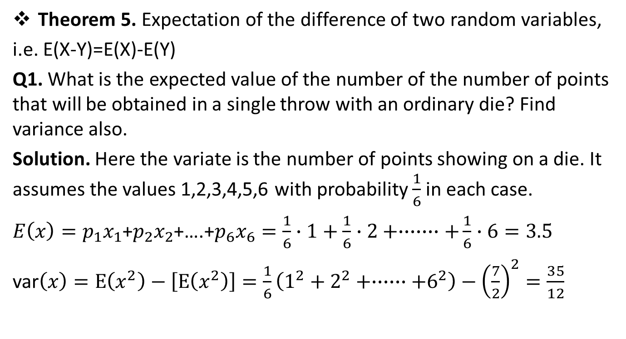

Mathematical expectation(CO2)
Theorem 5. Expectation of the difference of two random variables,
i.e. E(X-Y)=E(X)-E(Y)
Q1. What is the expected value of the number of the number of points that will be obtained in a single throw with an ordinary die? Find variance also.
Solution. Here the variate is the number of points showing on a die. It assumes the values 1,2,3,4,5,6 with probability $\frac{1}{6}$ in each case.
$E\left(x\right)=p_{1}x_{1}$+$p_{2}x_{2}$+….+$p_{6}x_{6}=\frac{1}{6}∙1+\frac{1}{6}∙2+∙∙∙∙∙∙∙+\frac{1}{6}∙6=3.5$
var$\left(x\right)=E\left(x^{2}\right)−\left[E\left(x^{2}\right)\right]=\frac{1}{6}\left(1^{2}+2^{2}+∙∙∙∙∙∙+6^{2}\right)−{\left(\frac{7}{2}\right)}^{2}=\frac{35}{12}$
$$∙$$

Slide 51
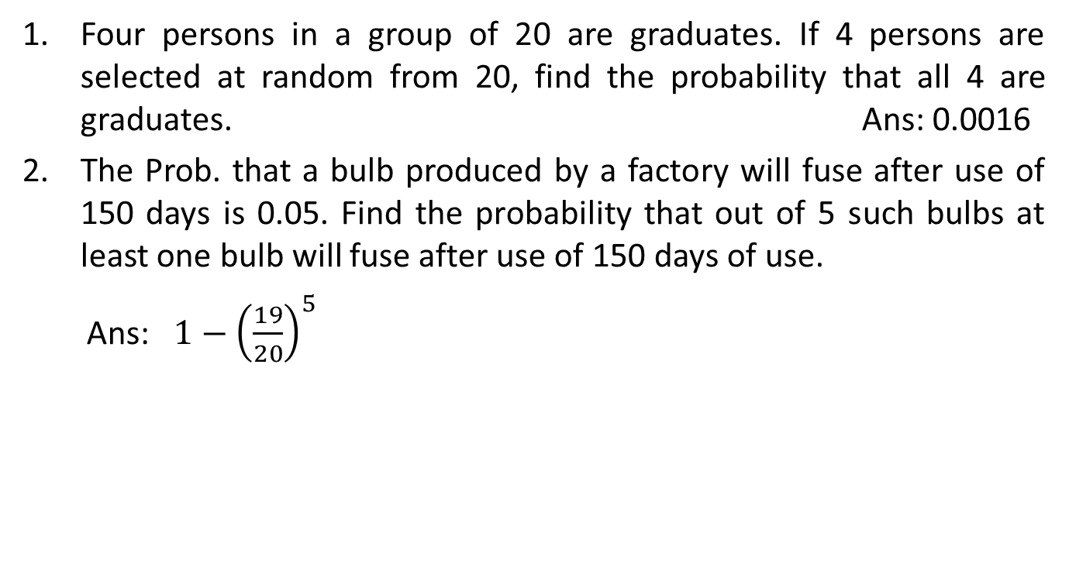
Daily Quiz(CO2)
Four persons in a group of 20 are graduates. If 4 persons are selected at random from 20, find the probability that all 4 are graduates. Ans: 0.0016
The Prob. that a bulb produced by a factory will fuse after use of 150 days is 0.05. Find the probability that out of 5 such bulbs at least one bulb will fuse after use of 150 days of use.
Ans: $1−{\left(\frac{19}{20}\right)}^{5}$
Unit II

Slide 52
Faculty Video Links, Youtube & NPTEL Video Links and Online Courses Details
Video Link:
Bay’s theorem
https://www.youtube.com/watch?v=GSEu5hn2q98
Conditional probability
https://youtu.be/hxn_QwwWZBQ
Unit II

Slide 53
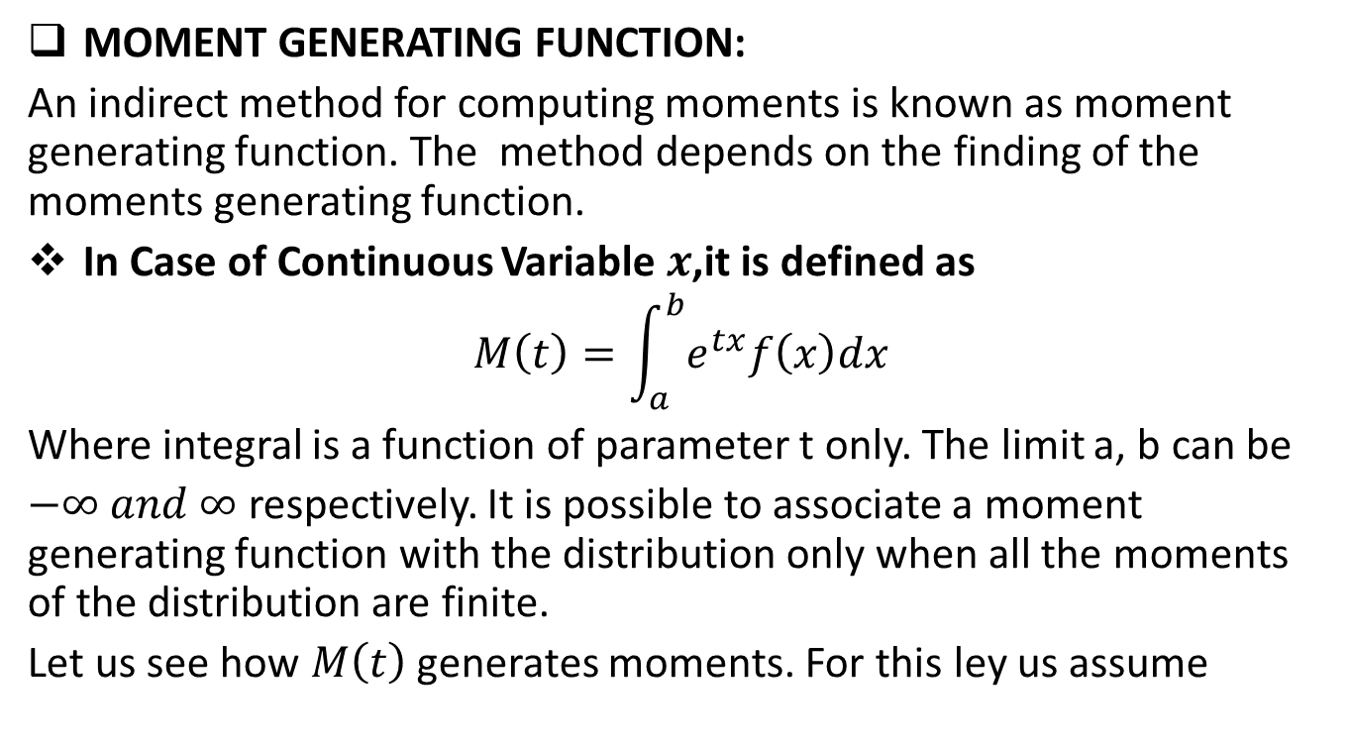
MOMENT GENERATING FUNCTION(CO2)
MOMENT GENERATING FUNCTION:
An indirect method for computing moments is known as moment generating function. The method depends on the finding of the moments generating function.
In Case of Continuous Variable $x$,it is defined as
$$M\left(t\right)=\int_{a}^{b}{e^{tx}f\left(x\right)dx}$$
Where integral is a function of parameter t only. The limit a, b can be
$−∞ and ∞$respectively. It is possible to associate a moment generating function with the distribution only when all the moments of the distribution are finite.
Let us see how $M\left(t\right)$generates moments. For this ley us assume

Slide 54
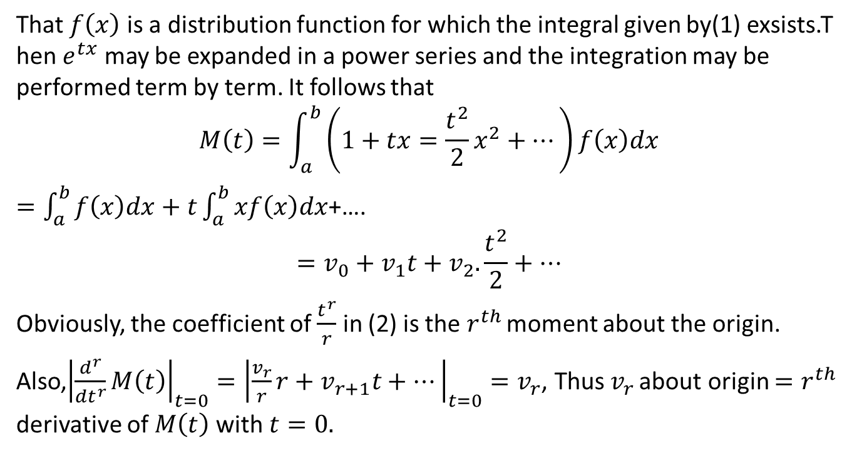
MOMENT GENERATING FUNCTION(CO2)
That $f\left(x\right)$ is a distribution function for which the integral given by(1) exsists.T hen $e^{tx}$ may be expanded in a power series and the integration may be performed term by term. It follows that
$$M\left(t\right)=\int_{a}^{b}{\left(1+tx=\frac{t^{2}}{2}x^{2}+…\right)f\left(x\right)dx}$$
$=\int_{a}^{b}{f\left(x\right)dx+t\int_{a}^{b}{xf\left(x\right)dx}}$+….
$$=v_{0}+v_{1}t+v_{2}.\frac{t^{2}}{2}+…$$
Obviously, the coefficient of $\frac{t^{r}}{r}$ in (2) is the $r^{th }$moment about the origin.
Also,${\left|\frac{d^{r}}{{dt}^{r}}M\left(t\right)\right|}_{t=0}={\left|\frac{v_{r}}{r}r+v_{r+1}t+…\right|}_{t=0}=v_{r}$, Thus $v_{r }$about origin $=r^{th}$ derivative of $M\left(t\right)$with $t=0.$

Slide 55
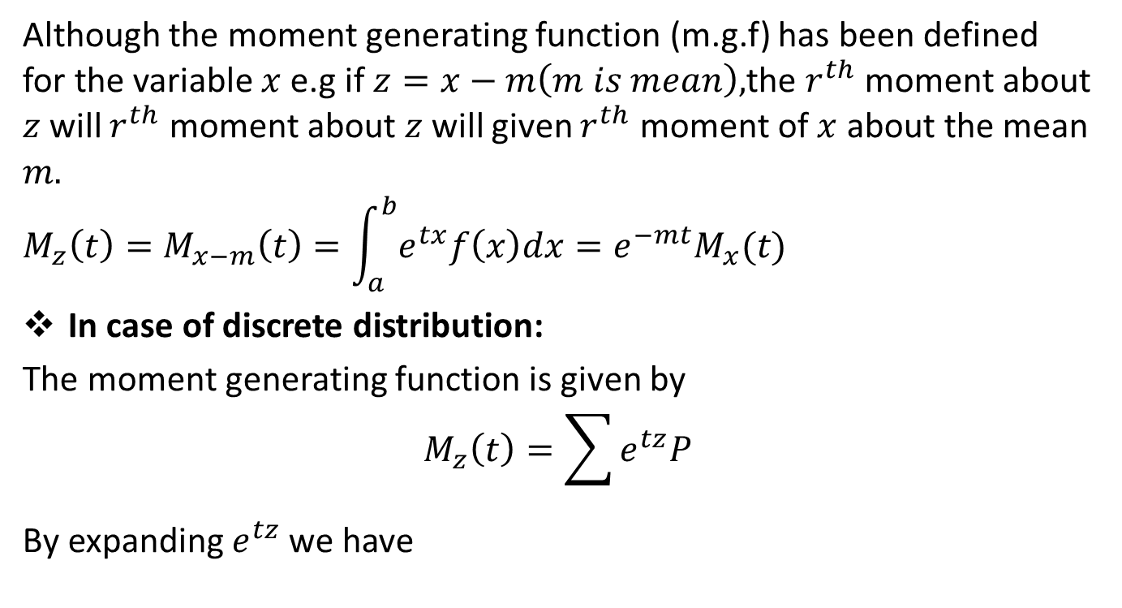
MOMENT GENERATING FUNCTION(CO2)
Although the moment generating function (m.g.f) has been defined for the variable $x$ e.g if $z=x−m\left(m is mean\right),$the $r^{th}$ moment about $z$will $r^{th}$ moment about $z$will given $r^{th}$ moment of $x$ about the mean $m.$
$$M_{z}\left(t\right)=M_{x−m}\left(t\right)=\int_{a}^{b}{e^{tx}f\left(x\right)dx=e^{−mt}M_{x}(t)}$$
In case of discrete distribution:
The moment generating function is given by
$$M_{z}\left(t\right)=\sum{e^{tz}P}$$
By expanding $e^{tz}$ we have

Slide 56
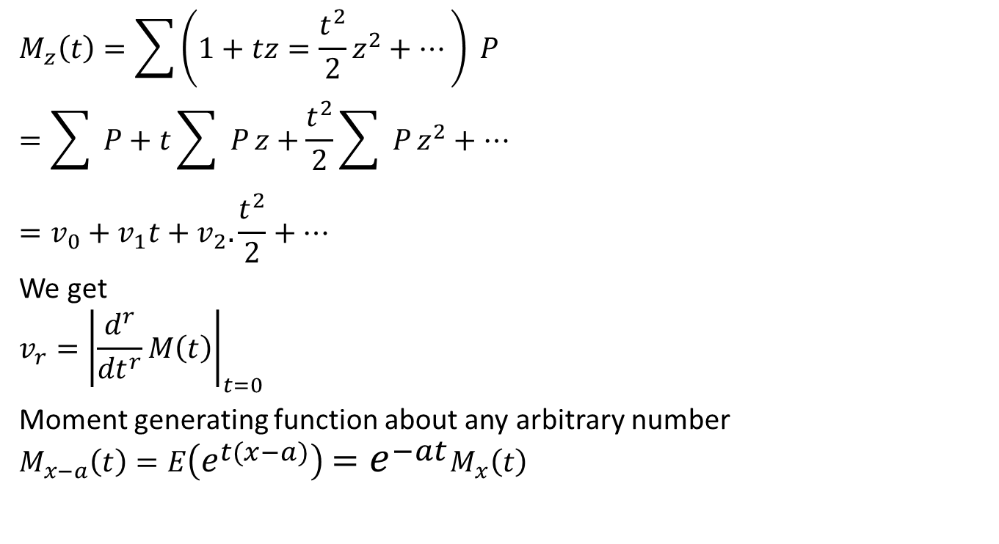
MOMENT GENERATING FUNCTION(CO2)
$$M_{z}\left(t\right)=\sum{\left(1+tz=\frac{t^{2}}{2}z^{2}+…\right) P}$$
$$=\sum{ P}+t\sum{ P}z+\frac{t^{2}}{2}\sum{ P}z^{2}+…$$
$$=v_{0}+v_{1}t+v_{2}.\frac{t^{2}}{2}+…$$
We get
$$v_{r}={\left|\frac{d^{r}}{{dt}^{r}}M\left(t\right)\right|}_{t=0}$$
Moment generating function about any arbitrary number
$$M_{x−a}\left(t\right)=E\left(e^{t\left(x−a\right)}\right)=e^{−at}M_{x}\left(t\right)$$

Slide 57
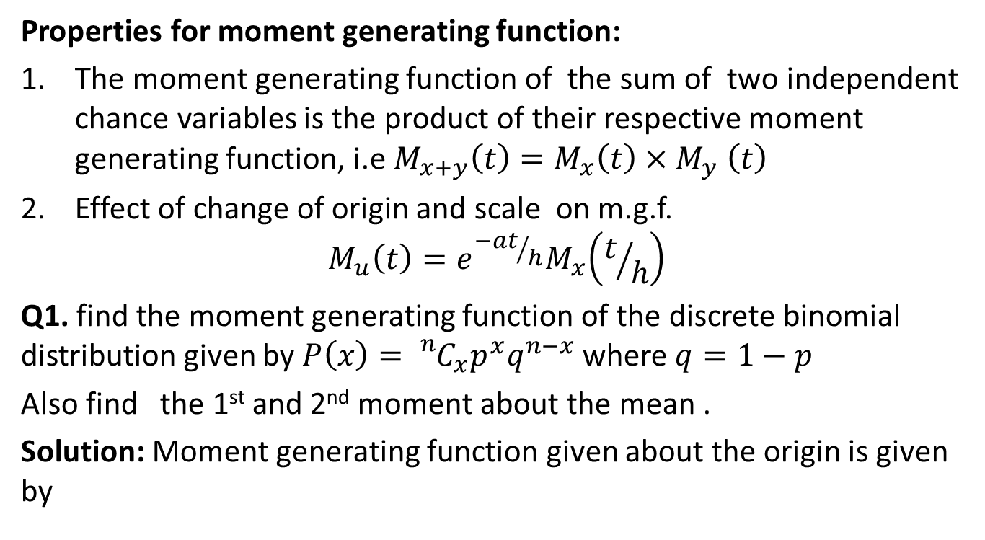
MOMENT GENERATING FUNCTION(CO2)
Properties for moment generating function:
The moment generating function of the sum of two independent chance variables is the product of their respective moment generating function, i.e${ M}_{x+y}\left(t\right)=M_{x}\left(t\right){×M}_{y}\left(t\right)$
Effect of change of origin and scale on m.g.f.
$$M_{u}\left(t\right)=e^{{−at}/h}M_{x}\left(t/h\right)$$
Q1. find the moment generating function of the discrete binomial distribution given by $P\left(x\right)={}_{}^{n}{C_{x}p^{x}q^{n−x}}$ where $q=1−p$
Also find the 1st and 2nd moment about the mean .
Solution: Moment generating function given about the origin is given by

Slide 58
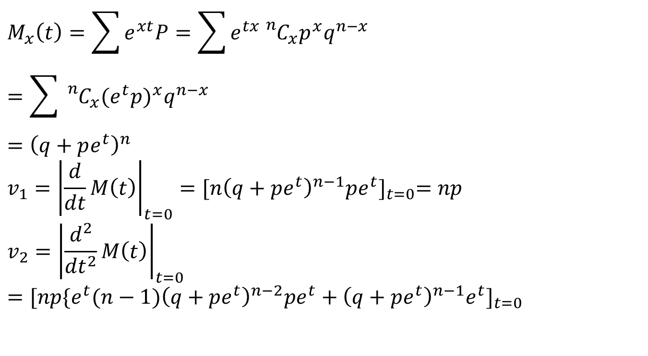
MOMENT GENERATING FUNCTION(CO2)
$$M_{x}\left(t\right)=\sum{e^{xt}P=\sum{e^{tx}{}_{}^{n}{C_{x}p^{x}q^{n−x}}} }$$
$$=\sum{{}_{}^{n}{C_{x}{(e^{t}p)}^{x}q^{n−x}}}$$
$$={\left(q+pe^{t}\right)}^{n}$$
$$v_{1}={\left|\frac{d}{dt}M\left(t\right)\right|}_{t=0}={[n{\left(q+pe^{t}\right)}^{n−1}pe^{t}]}_{t=0}=np$$
$$v_{2}={\left|\frac{d^{2}}{{dt}^{2}}M\left(t\right)\right|}_{t=0}={[np{\{e^{t}(n−1)\left(q+pe^{t}\right)}^{n−2}pe^{t}+{\left(q+pe^{t}\right)}^{n−1}e^{t}]}_{t=0}$$

Slide 59
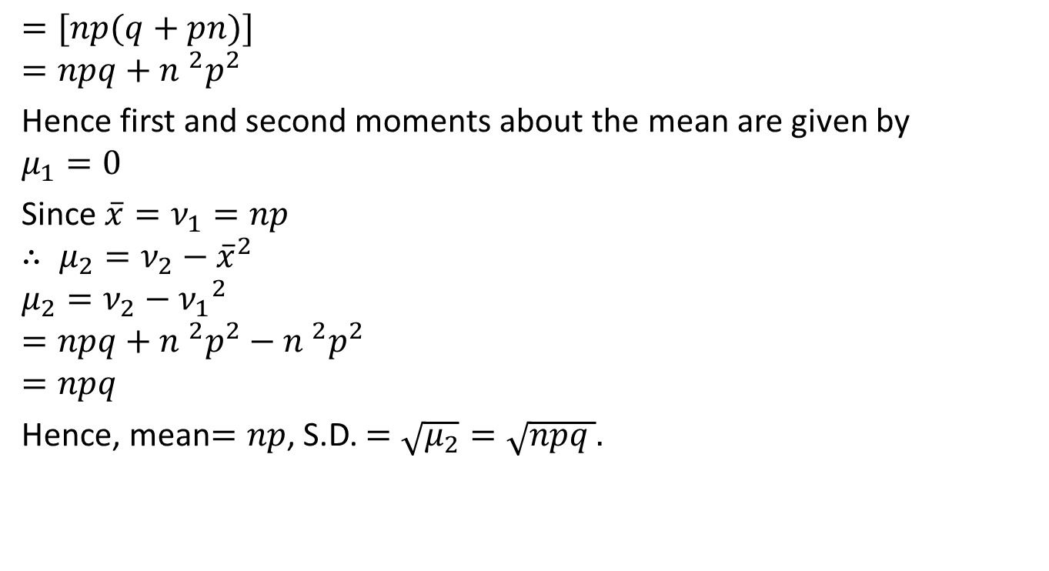
MOMENT GENERATING FUNCTION(CO2)
$$=[np(q+pn)]$$
$$=npq+{n }^{2}p^{2}$$
Hence first and second moments about the mean are given by
$$μ_{1}=0$$
Since $\overline{x}=ν_{1}=np$
$$∴ μ_{2}=ν_{2}−{\overline{x}}^{2}$$
$$μ_{2}=ν_{2}−{ν_{1}}^{2}$$
$$=npq+{n }^{2}p^{2}−{n }^{2}p^{2}$$
$$=npq$$
Hence, mean$=np$, S.D. $=\sqrt{μ_{2}}=\sqrt{npq }.$

Slide 60
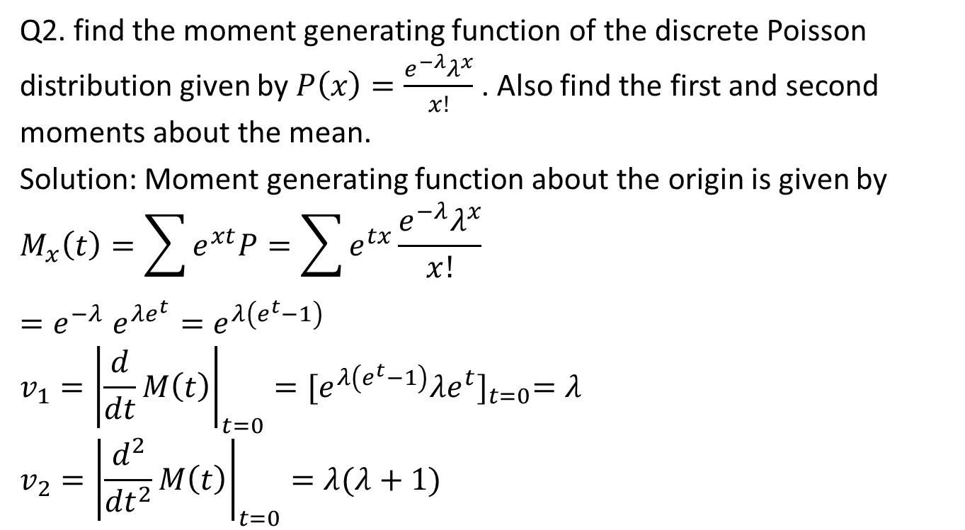
MOMENT GENERATING FUNCTION(CO2)
Q2. find the moment generating function of the discrete Poisson distribution given by $P\left(x\right)=\frac{e^{−λ}λ^{x}}{x!}$ . Also find the first and second moments about the mean.
Solution: Moment generating function about the origin is given by
$$M_{x}\left(t\right)=\sum{e^{xt}P=\sum{e^{tx}}\frac{e^{−λ}λ^{x}}{x!}}$$
$${=e}^{−λ}e^{λe^{t}}=e^{λ\left(e^{t}−1\right)}$$
$$v_{1}={\left|\frac{d}{dt}M\left(t\right)\right|}_{t=0}={[e^{λ\left(e^{t}−1\right)}λe^{t}]}_{t=0}=λ$$
$$v_{2}={\left|\frac{d^{2}}{{dt}^{2}}M\left(t\right)\right|}_{t=0}=λ(λ+1)$$

Slide 61
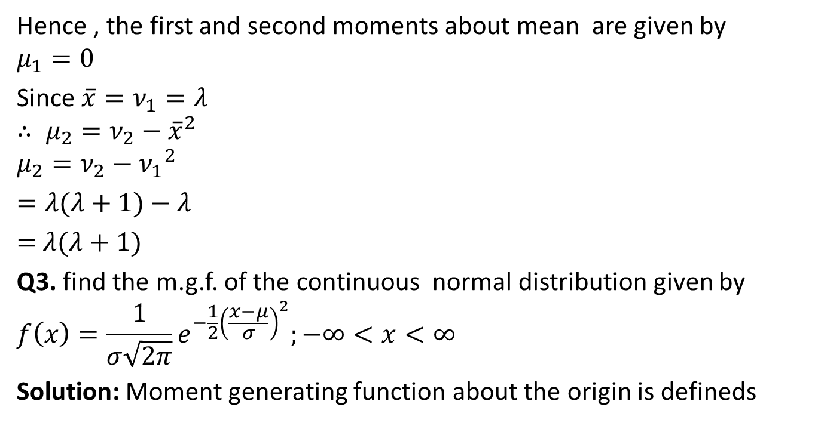
MOMENT GENERATING FUNCTION(CO2)
Hence , the first and second moments about mean are given by
$$μ_{1}=0$$
Since $\overline{x}=ν_{1}=λ$
$$∴ μ_{2}=ν_{2}−{\overline{x}}^{2}$$
$$μ_{2}=ν_{2}−{ν_{1}}^{2}$$
$=λ(λ+1)−$ $λ$
$=$ $λ(λ+1)$
Q3. find the m.g.f. of the continuous normal distribution given by
$$f\left(x\right)=\frac{1}{σ\sqrt{2π}}e^{−\frac{1}{2}{\left(\frac{x−μ}{σ}\right)}^{2}};−∞<x<∞$$
Solution: Moment generating function about the origin is defineds

Slide 62

MOMENT GENERATING FUNCTION(CO2)
$$M_{x}\left(t\right)=E\left(e^{tx}\right)=\int_{−∞}^{∞}{e^{tx}f\left(x\right)dx}$$
$$=\int_{−∞}^{∞}{e^{tx}\frac{1}{σ\sqrt{2π}}e^{−\frac{1}{2}{\left(\frac{x−μ}{σ}\right)}^{2}}dx}$$
$=\frac{1}{\sqrt{2π}}\int_{−∞}^{∞}{e^{−tσz}e^{−\frac{1}{2}z^{2}}dz}$; where $z=\frac{x−μ}{σ}$
$$=\frac{1}{\sqrt{2π}}e^{\left(μt+\frac{1}{2}t^{2}σ^{2}\right)}\int_{−∞}^{∞}{e^{−\frac{1}{2}({z−tσ)}^{2}}dz}$$
$$=e^{\left(μt+\frac{1}{2}t^{2}σ^{2}\right)}.1$$
$${=e}^{\left(μt+\frac{1}{2}t^{2}σ^{2}\right)}$$

Slide 63

Daily Quiz(CO2)
Q1. Find the moment generating function about origin of a random variable $X$ whose probability density function is given by
$f\left(x\right)= \frac{1}{2}e^{−\left|x\right|}.$

Slide 64
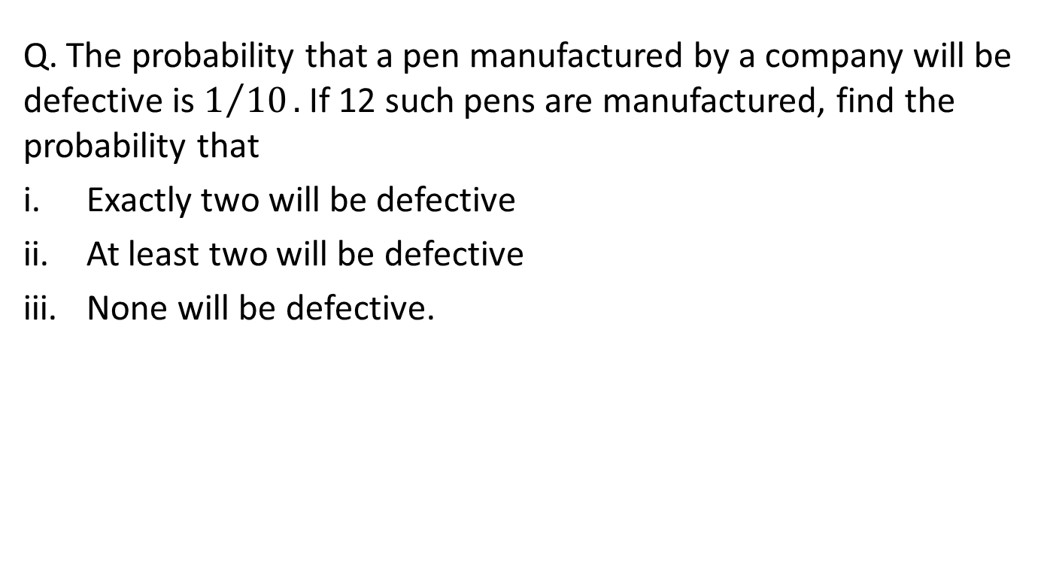
Daily Quiz(CO2)
Q. The probability that a pen manufactured by a company will be defective is $1/{10}.$ If 12 such pens are manufactured, find the probability that
Exactly two will be defective
At least two will be defective
None will be defective.
Unit II

Slide 65
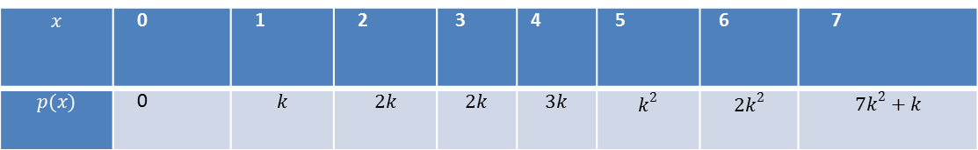
Daily Quiz(CO2)
Q1. A random variable $X$ has the following probability mass function:
Find $k.$
Evaluate $P\left(X<6\right),P(X≥6)$ and $P\left(0<X<5\right).$
If $P\left(X≤a\right)>\frac{1}{2}$ find the minimum value of $a.$
Determine the distribution function of $X.$
$$x$$ | 0 | 1 | 2 | 3 | 4 | 5 | 6 | 7
$$p(x)$$ | 0 | $$k$$ | $$2k$$ | $$2k$$ | $$3k$$ | $$k^{2}$$ | $${2k}^{2}$$ | $${7k}^{2}+k$$
Unit II

Slide 66
Daily Quiz(CO2)
Q2. In a bolt factory machines A,B and C manufacture 25%,35% and 40% of the total. Of their output 5%,4% and 2% are defective bolts. A bolt is drawn at random from the product and is found to be defective. What are the probabilities that it was manufactured by machines A,B or C?
Unit II

Slide 67

Weekly Assignment(CO2)
Q1.The probability that machine A will be performing an usual function in 5 years’ time is $\frac{1}{4}$ , while the probability that machine B will be operating usefully at the end of the same period is $\frac{1}{3}$ .
Find the probability that in the following cases that in 5 years’ time:
Both machines will be performing an usual function
Neither will be operating.
Only machine B will be operating
At least one of the machines will be operating.Ans: $\frac{1}{12} ,\frac{1}{2} ,\frac{1}{4} ,\frac{1}{2}$
Unit II

Slide 68

Weekly Assignment(CO2)
Q2.In a bolt factory machines A,B and C manufacture 25%,35% and 40% of the total. Of their output 5%,4% and 2% are defective bolts. A bolt is drawn at random from the product and is found to be defective. What are the probabilities that it was manufactured by machines A,B or C? Ans: $\frac{25}{69} ,\frac{28}{69} ,\frac{16}{69}$
Q3.In 800 families with 5 children each ,how many families would be expected to have
3 boys and 2 girls
No girl
At most 2 girls
Either 2 or 3 boys (Assume equal probabilities for boys and girls) Ans: 250, 25, 400, 25
Unit II

Slide 69
Weekly Assignment(CO2)
Q4.In a test on 2000 electric bulbs, it was found that the life of a particular make, was normally distributed with an average life of 2040 hours and S.D. of 60 hours, estimate the number of bulbs likely to burn for
More than 2150 hours
Less than 1950 hours
More than 1920 hours but less than 2160 hours Ans: 67,134,1909
Unit II

Slide 70

MCQ s(CO2)
Q1. Four person are chosen at random from a group containing 3 men, 2 women and 4 children then the probability that exactly two of them will be children is
$\frac{9}{21}$
$\frac{10}{21}$
$\frac{6}{21}$
None of these
Q 2. In a certain state, 25 percent of all cars emit excessive amounts of pollutants. If the probability is 0.99 that a car emitting excessive amounts will fail the state’s vehicular emission test, and the probability is 0.17 that a car not emitting excessive amounts of pollutants will
Unit II

Slide 71
MCQ s(CO2)
nevertheless fail the test. What is the probability that a car that fails the test actually emits excessive amounts of pollutants?
0.60
0.70
0.66
None of these
Q3. A can hit a target 3 times in 5 shots, B 2 times in 5 shots and C 3 times in 4 shots. All of them fire one shot each simultaneously at the target. What is the probability that at least two shots hit-
0.60
0.62
0.63
0.50
Unit II

Slide 72

MCQ s(CO2)
Q4. The probability that a civilian can hit a target is 2/5 and the probability that an army officer can hit the same target is 3/5 while the civilian can fire 8 shots in the time the army officer fires 10 shots. If they fire together, then what is the probability that army officer shoots the target?
$\frac{6}{11}$
$\frac{5}{11}$
$\frac{3}{11}$
None of these
Q 5The p.d.f$f(x)$ of a continuous random variable $x$ is defined by- $f\left(x\right)=\left\{\begin{aligned}\frac{A}{x^{3}}, 5≤x≤10 \\ 0, otherwise\end{aligned}\right.$ . Then the value of $A$ is-
Unit II

Slide 73

MCQ s(CO2)
$\frac{100}{3}$
$\frac{200}{3}$
$\frac{50}{3}$
None of these
Unit II

Slide 74
Old Question Papers(CO2)
Unit II

Slide 75
Expected Questions for University
Exam(CO2)
Q.1A bag contains 5 white and 8 red balls. Two successive drawing of 3 balls are made such that
(i) the balls are replaced before the second trial, and
(ii)the balls are not replaced before the second trial.
Find the probability that the first drawing will give 3 white and the second 3 red balls in each case.
Q.2The experience shows that 4 accidents occur in a plant on an average per month. Calculate the probabilities of less than 3 accidents in a certain month. Use Poisson distribution. (Given e⁻⁴=0.01832).
Q.3As a result of tests on 20,000 electric bulbs manufactured by a company it was found that the life time of a bulb was normally distributed with an average life of 2040 hours and standard deviation of 60 hours. On the basis of the information, estimate the number of bulbs that is expected to burn for
(i) more than 2150 hours, and (ii) less than 1960 hours.
Unit II

Slide 76
Expected Questions for University
Exam(CO2)
Q.4 Define Probability? State Addition and Multiplication theorems of probability by giving suitable example.
Q.5 Write short notes on Baye’s Theorem.
Unit II

Slide 77
Summary
Students have taught the importance of the following topics….
The concept of probability theory.
A basic knowledge in probability theory.
Able to reflect developed mathematical methods in probability and statistics.
Addition Law of Probability
Multiplication Law of Probability
Conditional Probability
Bayes’ Theorem
PMF, PDF
Expectation

Slide 78
References
Introduction to Statistics - P.K. Giri & J. Banerjee.
Statistical Models: Theory and Practice by David Freedman.
Richard I. Levin, David S. Rubin “Statistics for Management”, Pearson Education
Anderson, Sweeney and Williams “Statistics for Business and Economics”, Cengage Learning.
Slideshare
Unit II

